Slide 1
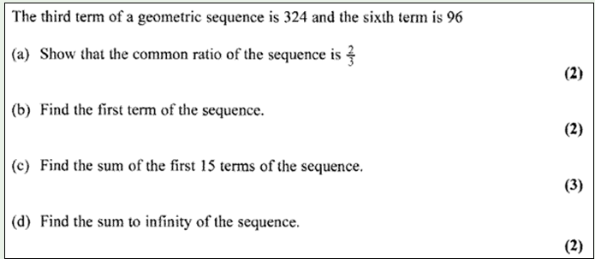
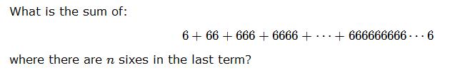
Year 12 HW – Geometric Series
Part 1 – Copy and complete table.
Self mark from answers.
Part 2 – Exam question
Try this after researching convergent geometric series and sum to infinity.
Use Khan Academy, mymaths or another source of your choice.
Part 3 - Optional challenge question:
This is tough!
See how far you can get.

