Slide 1




Core 2
Revision Past Paper Questions
(Edexcel)
Go back to home screen to select a topic
Go back to topic screen to select a question
Go to the mark scheme for that question
Go back to the question from the mark scheme
Or see more solutions
Or go back to first solutions
Next

Slide 2





Notes on operating this resource
When creating this, I used and to quickly navigate between slides directly before or after the slide in question.
As some mark schemes give additional notes, you can continue to see answers by clicking but you will not return to the original question with one click of .
To view the original question again, continue to click which should take you back.

Slide 3

Home
Factors
Trigonometry
Circles
Logarithms
Differentiation
Integration
Radians
Geometric Sequences and Series
Binomial Expansion
Cheat sheet example

Slide 4
The Binomial Expansion
Jan 2006
Jan 2010
May 2006
June 2010
Jan 2007
Jan 2011
May 2007
May 2011
Jan 2008
Jan 2012
June 2008
May 2012
Jan 2009
Jan 2013
June 2009
May 2013

Slide 5
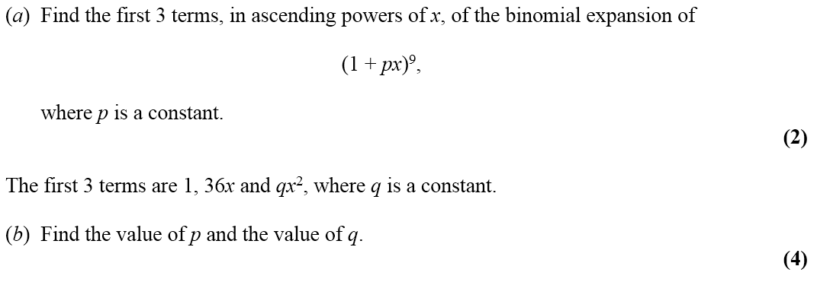
Jan 2006

Slide 6
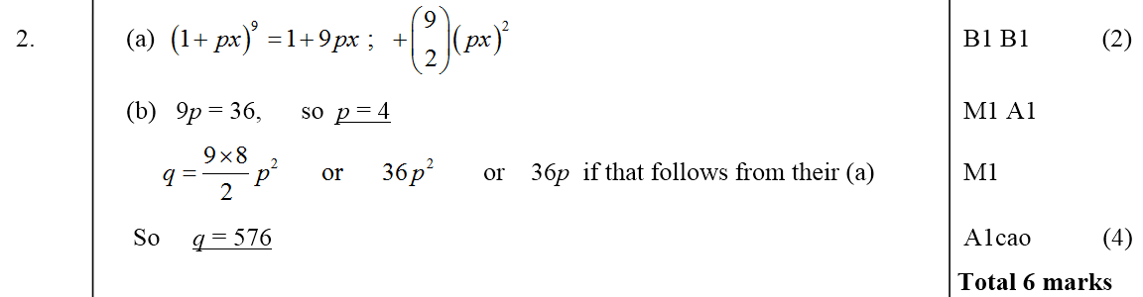
Jan 2006
A
B

Slide 7
May 2006

Slide 8
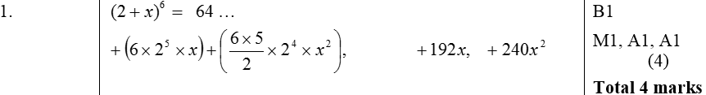
May 2006
A

Slide 9
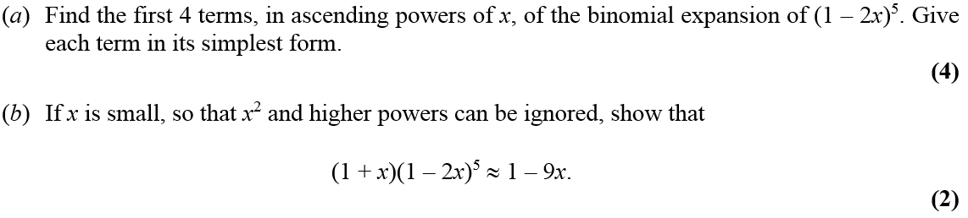
Jan 2007

Slide 10
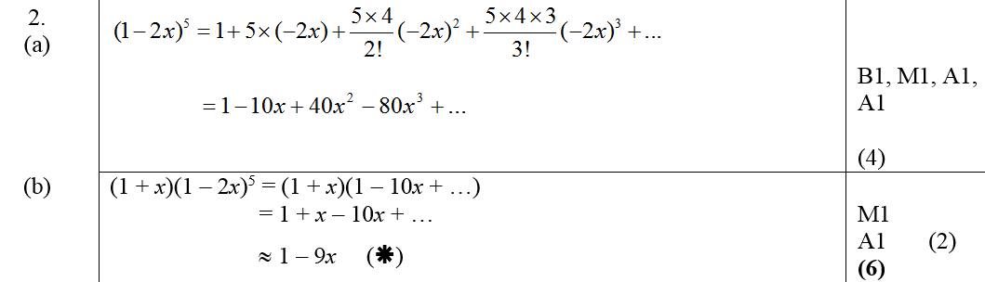
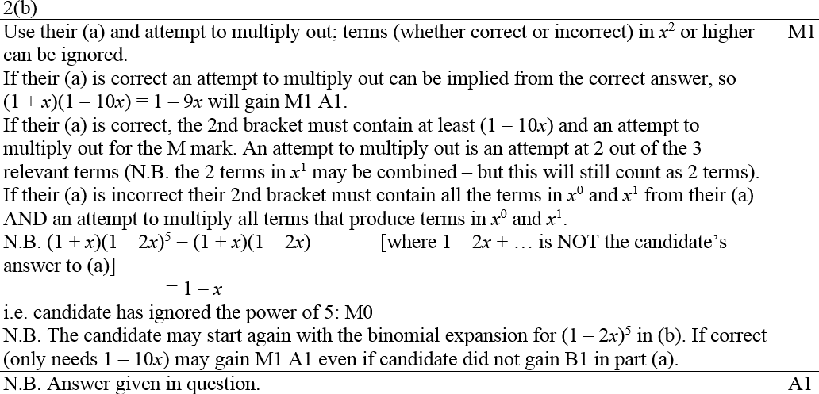


Jan 2007
A
B
B notes

Slide 11
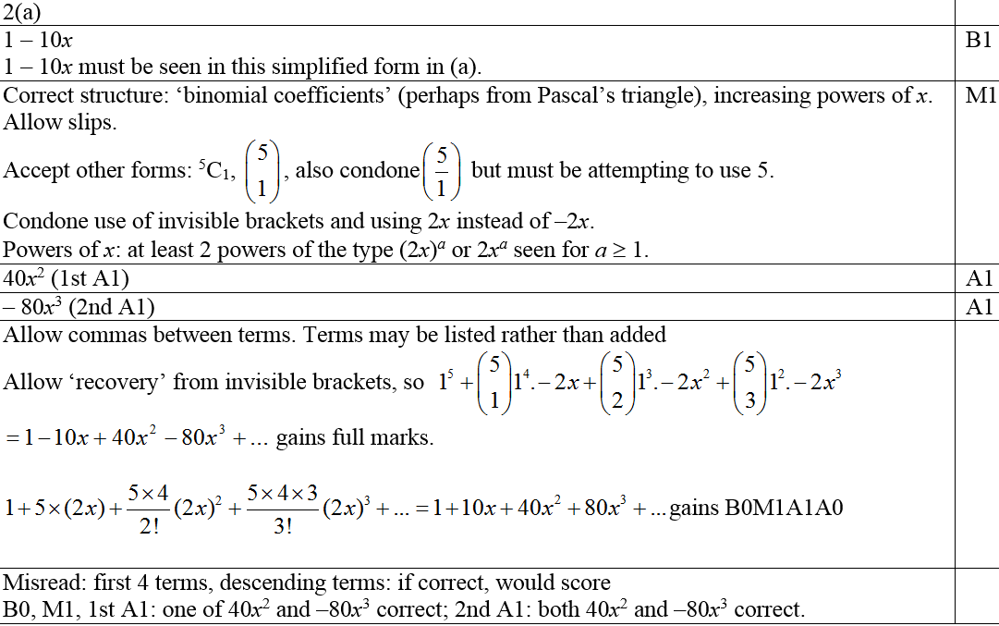
Jan 2007
A notes

Slide 12
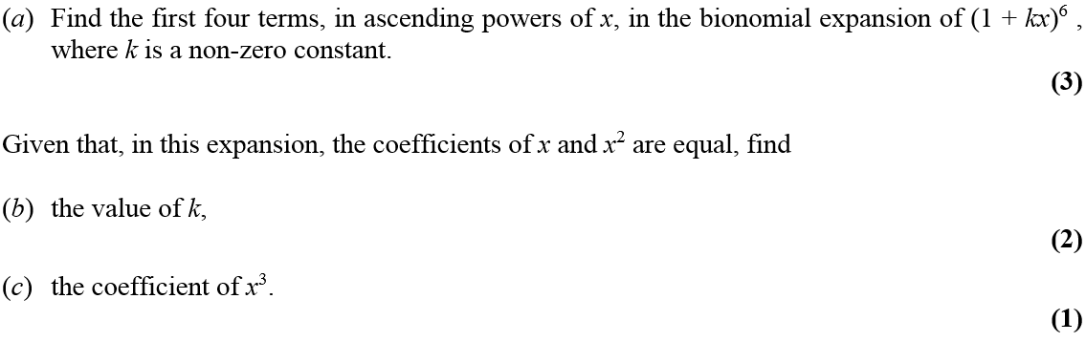
May 2007

Slide 13
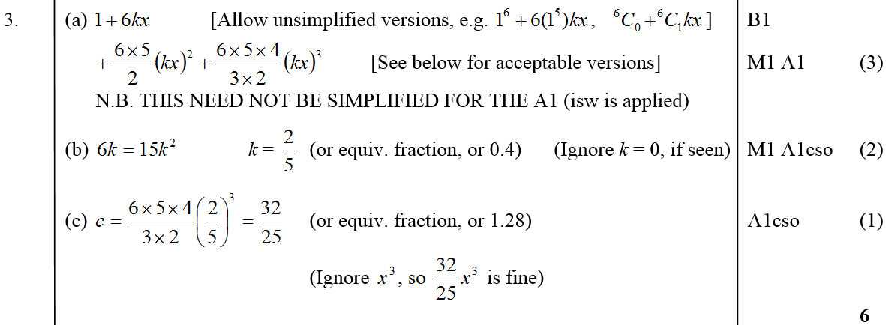
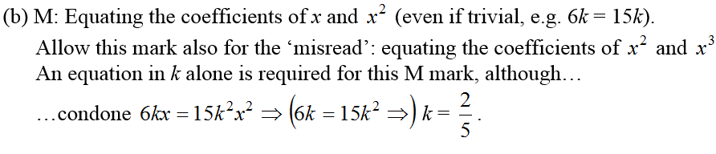
May 2007
A
B
C
B notes

Slide 14
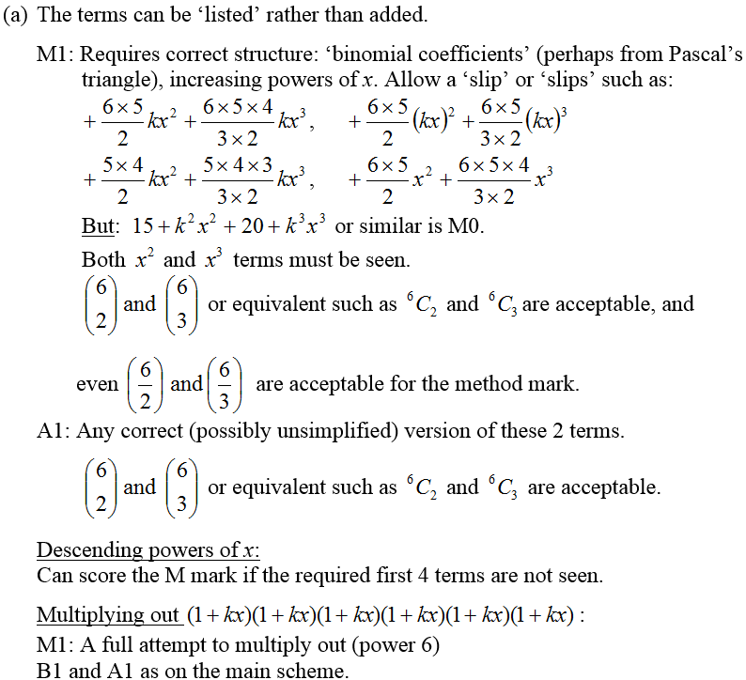
May 2007
A notes

Slide 15
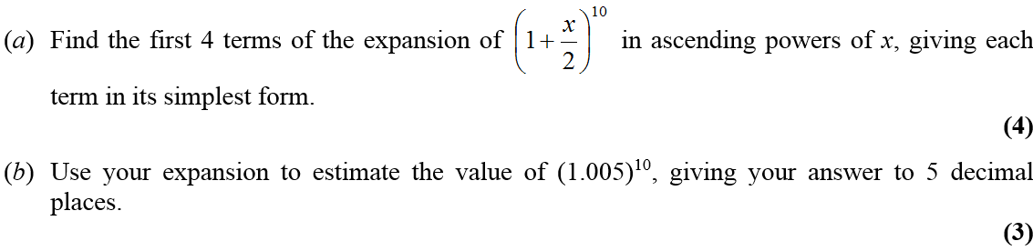

Jan 2008

Slide 16
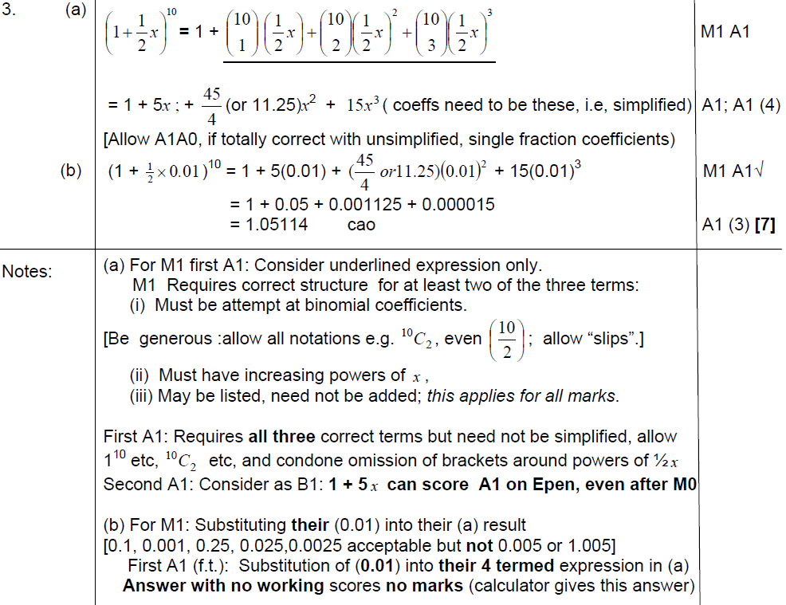
A
Jan 2008
B
A notes
B notes

Slide 17
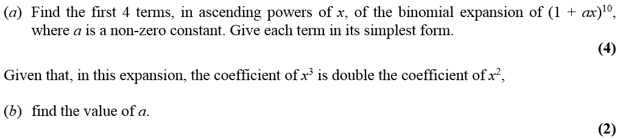
June 2008

Slide 18
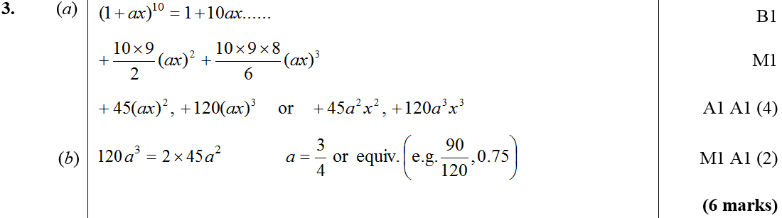
June 2008
A
B

Slide 19

Jan 2009

Slide 20
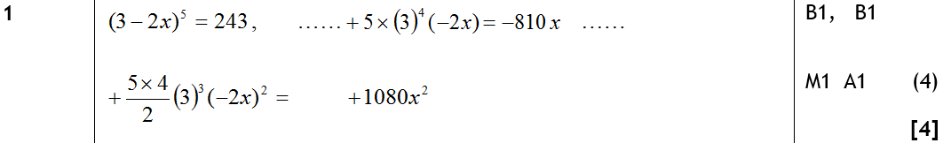
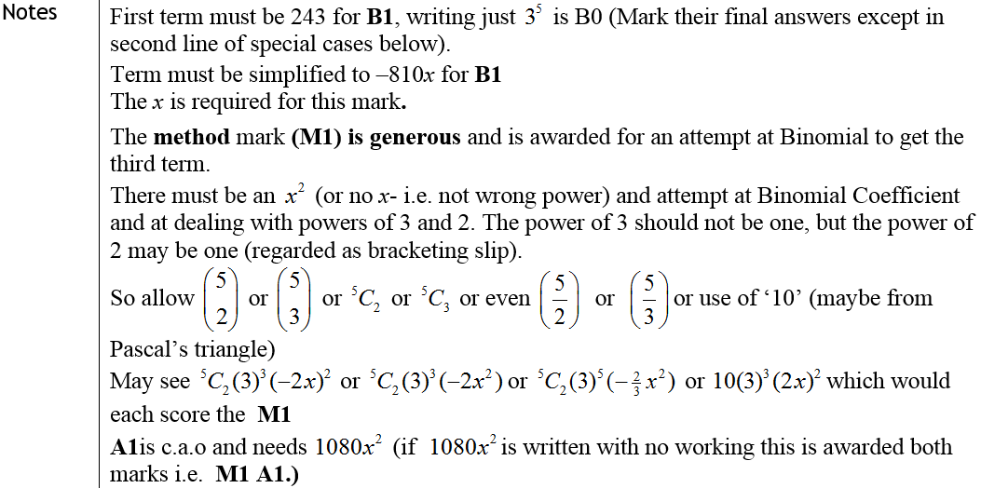


Jan 2009
A
Notes

Slide 21
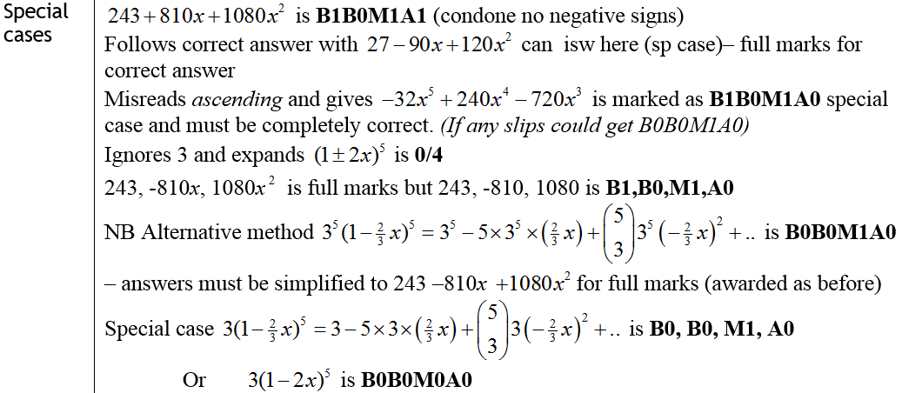
Jan 2009
Special Cases

Slide 22
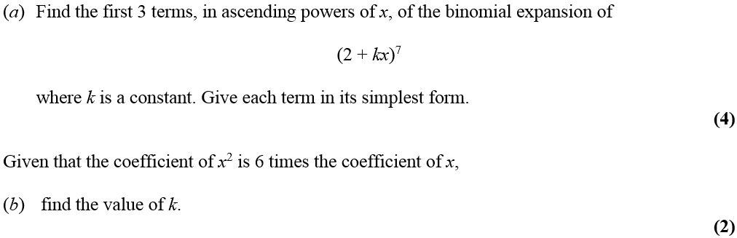
June 2009

Slide 23
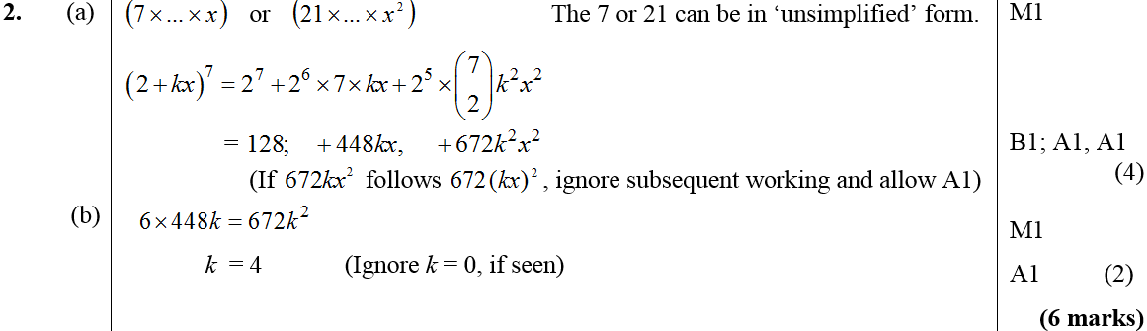
June 2009
A
B

Slide 24
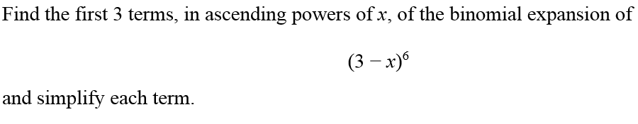


Jan 2010

Slide 25
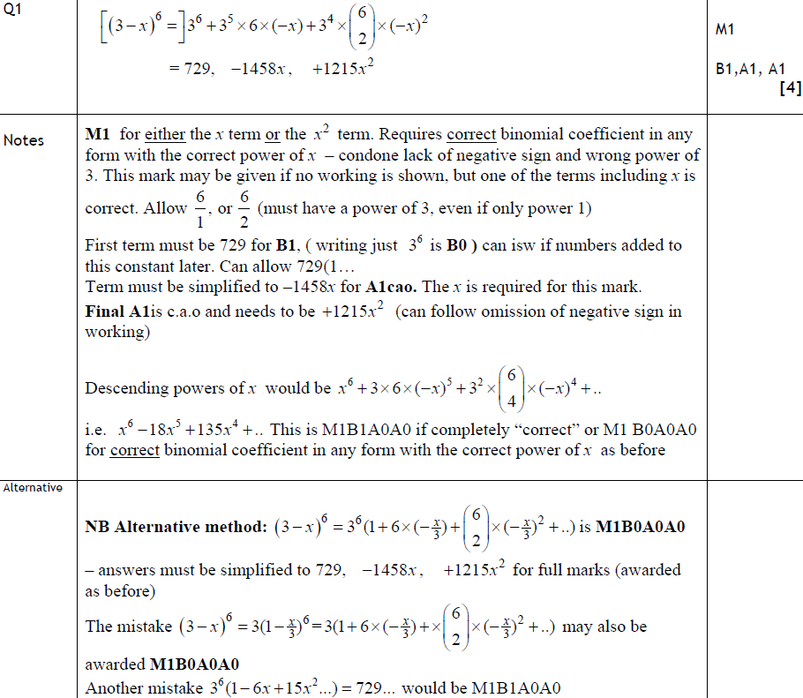
Jan 2010
A
Notes
Alternative Method

Slide 26
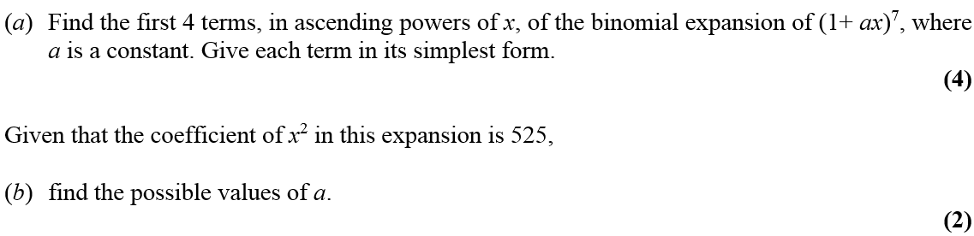

June 2010

Slide 27
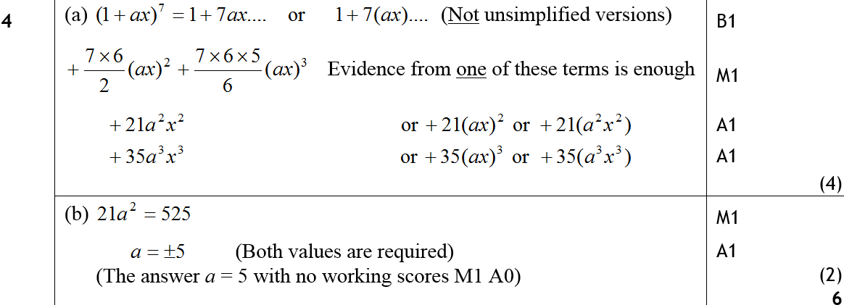
June 2010
A
B

Slide 28
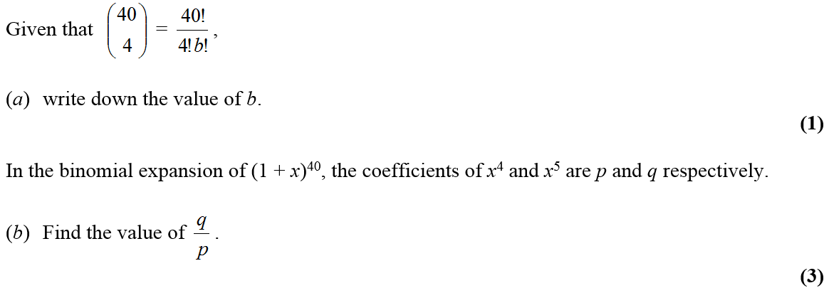
Jan 2011

Slide 29
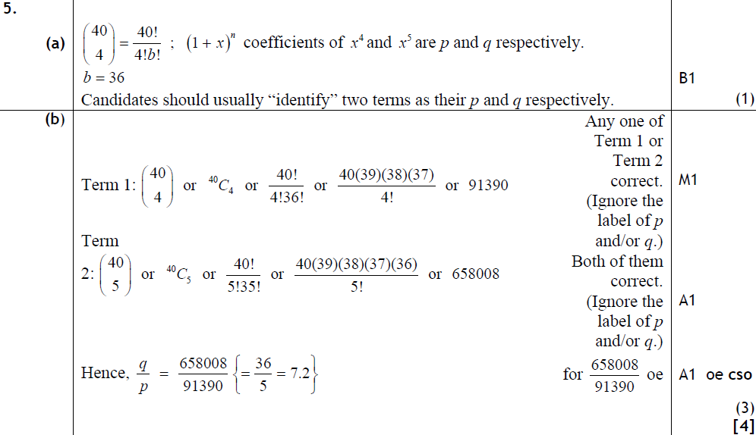
Jan 2011
A
B

Slide 30
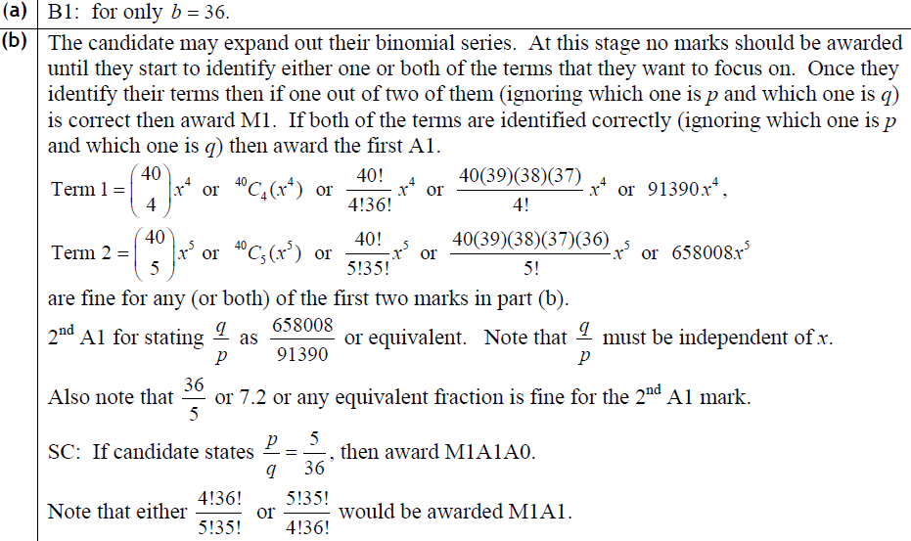
Jan 2011
A
B

Slide 31
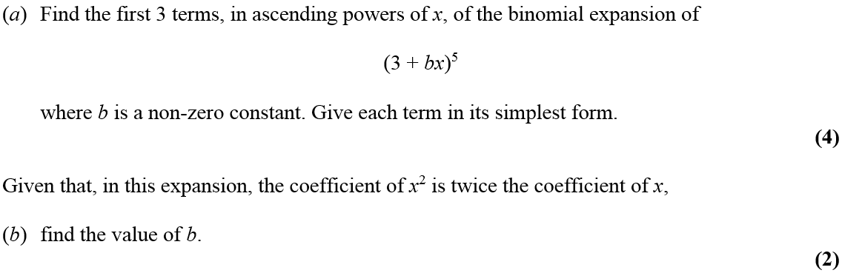
May 2011

Slide 32
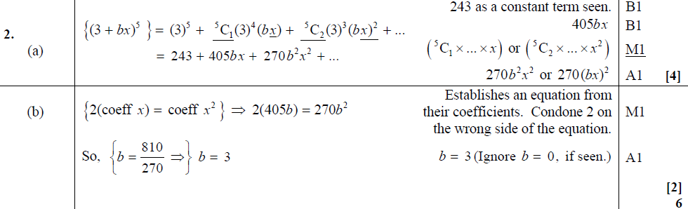
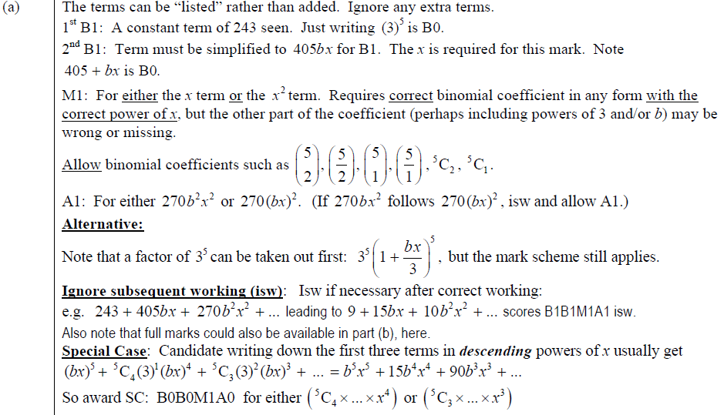
May 2011
A
B
A

Slide 33
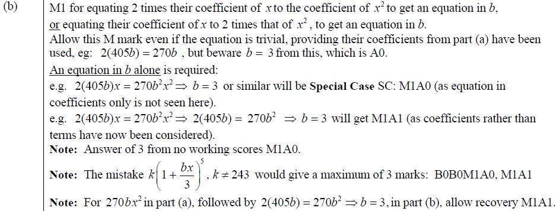
May 2011
B

Slide 34
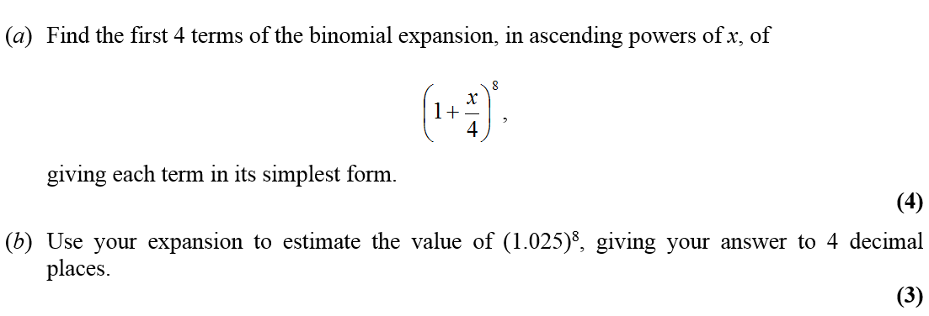
Jan 2012

Slide 35
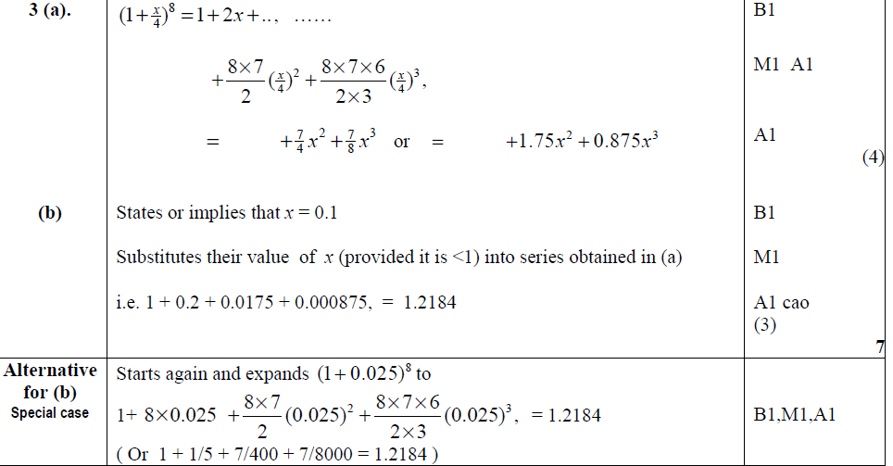
Jan 2012
A
B
Alternative B

Slide 36
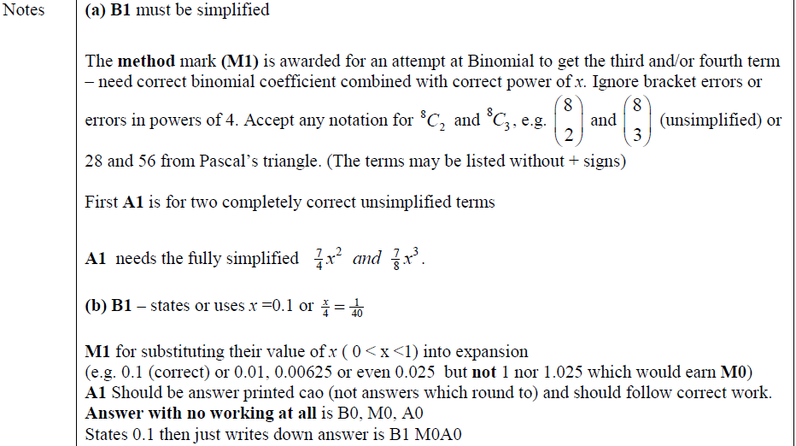
Jan 2012
A
B

Slide 37
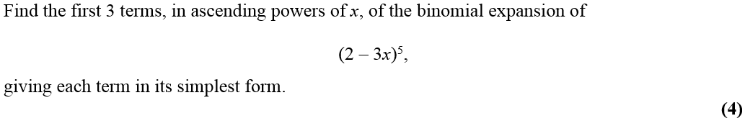
May 2012

Slide 38
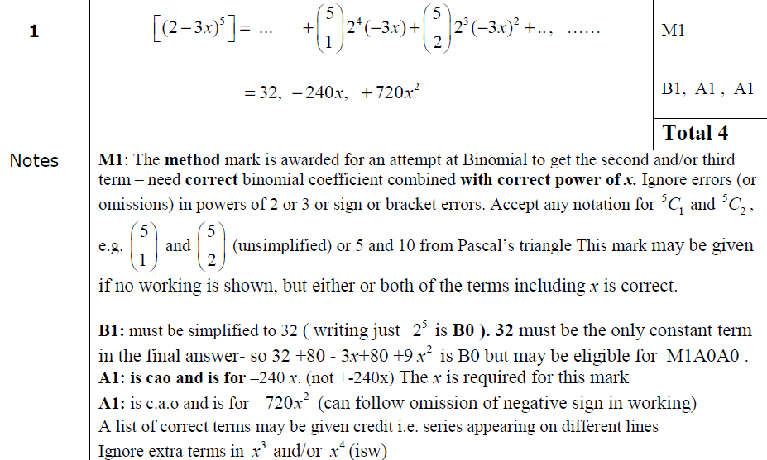
May 2012
A

Slide 39
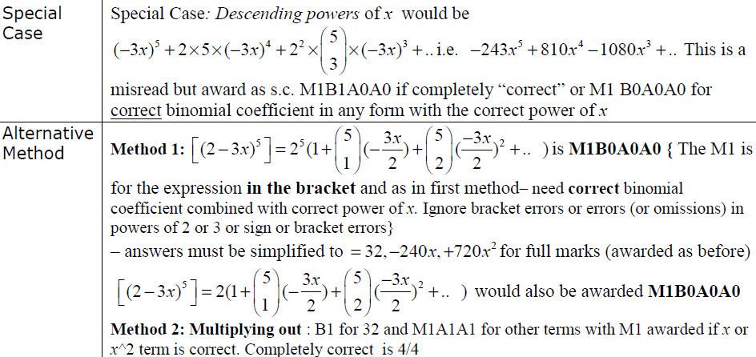
May 2012
Special Case
Alternative Methods

Slide 40
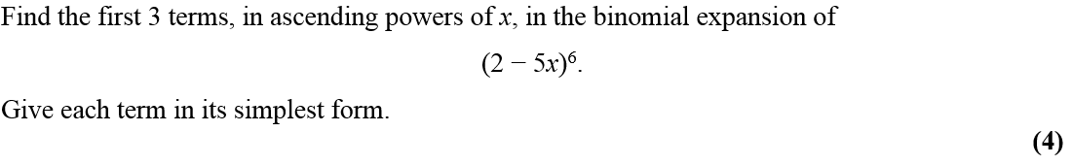
Jan 2013

Slide 41
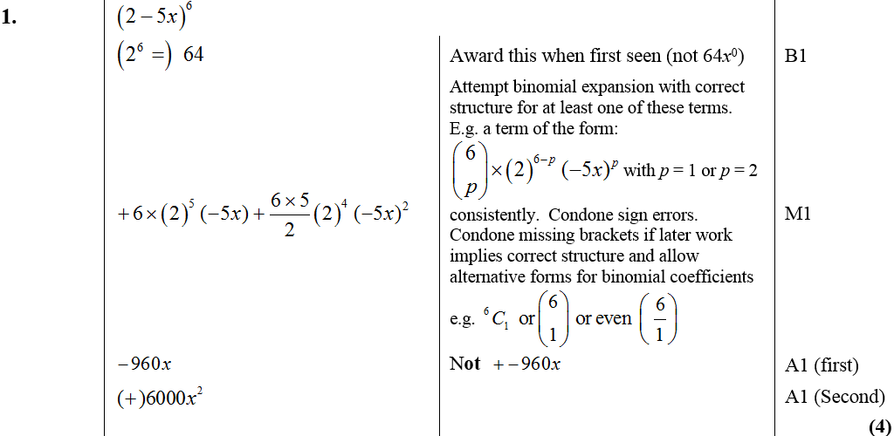
Jan 2013
A

Slide 42
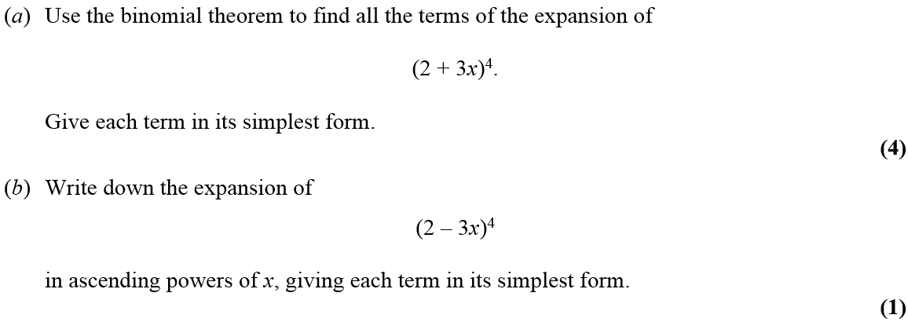

May 2013

Slide 43
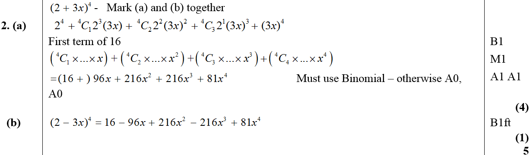
May 2013
A
B

Slide 44
Trigonometry
Jan 2006
June 2009
May 2006
Jan 2010
Jan 2007
June 2010
May 2007 (i)
Jan 2011
May 2007 (ii)
May 2011
Jan 2008 (i)
Jan 2012
Jan 2008 (ii)
May 2012
June 2008
Jan 2013
Jan 2009
May 2013

Slide 45
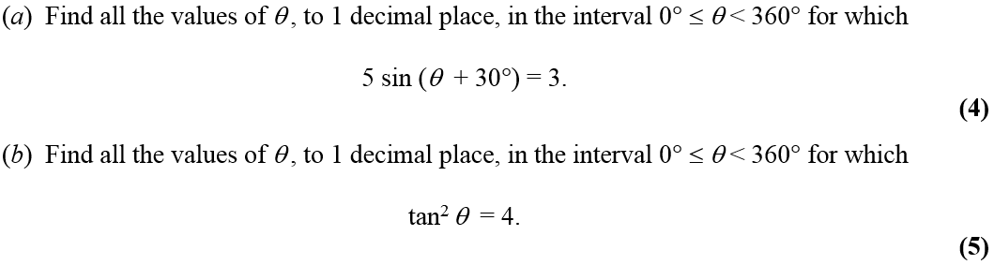
Jan 2006

Slide 46
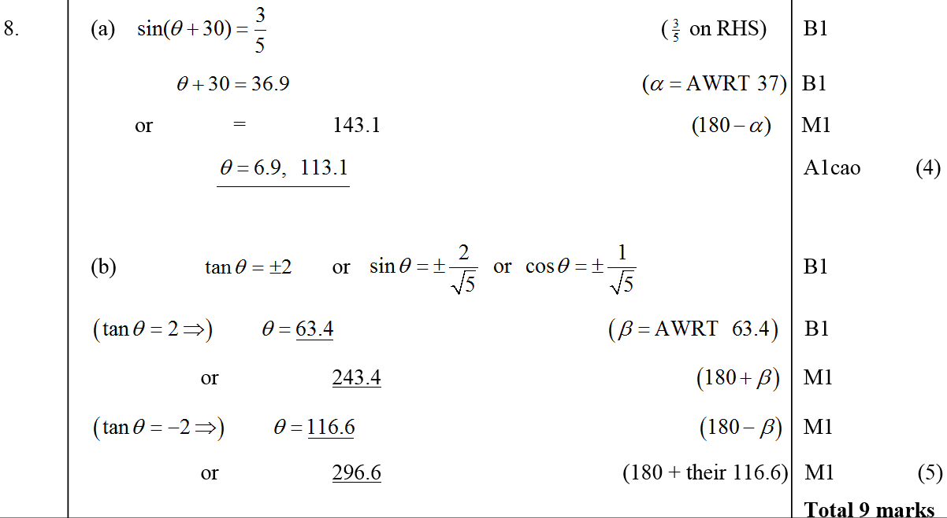
Jan 2006
A
B

Slide 47
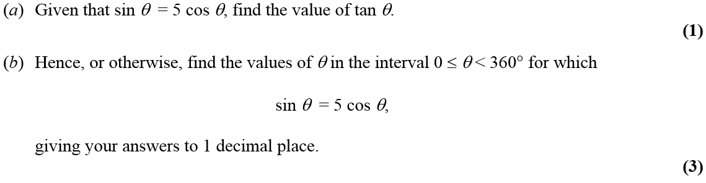
May 2006

Slide 48
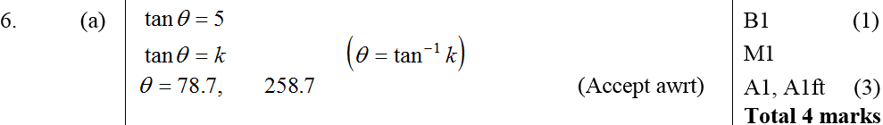
May 2006
A
B

Slide 49
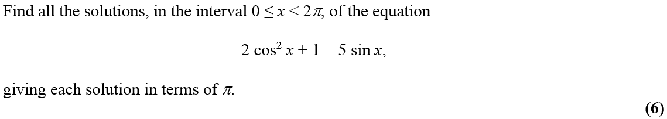
Jan 2007

Slide 50
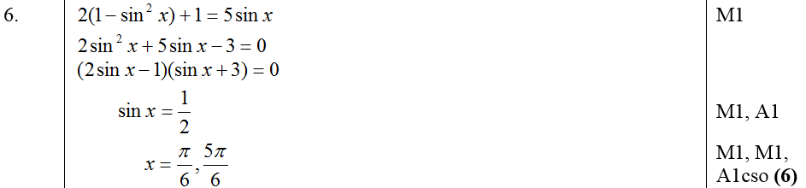
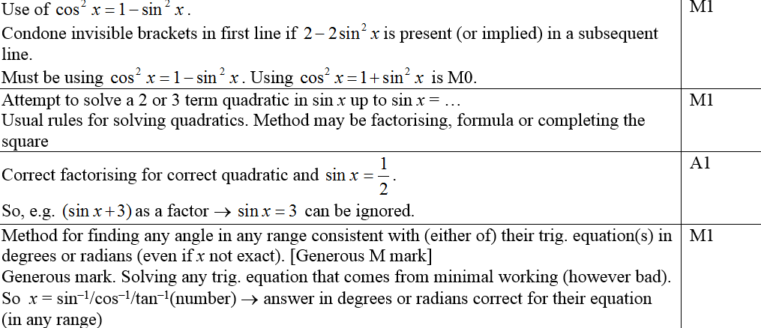
Jan 2007
A
Notes (first 4 marks)

Slide 51
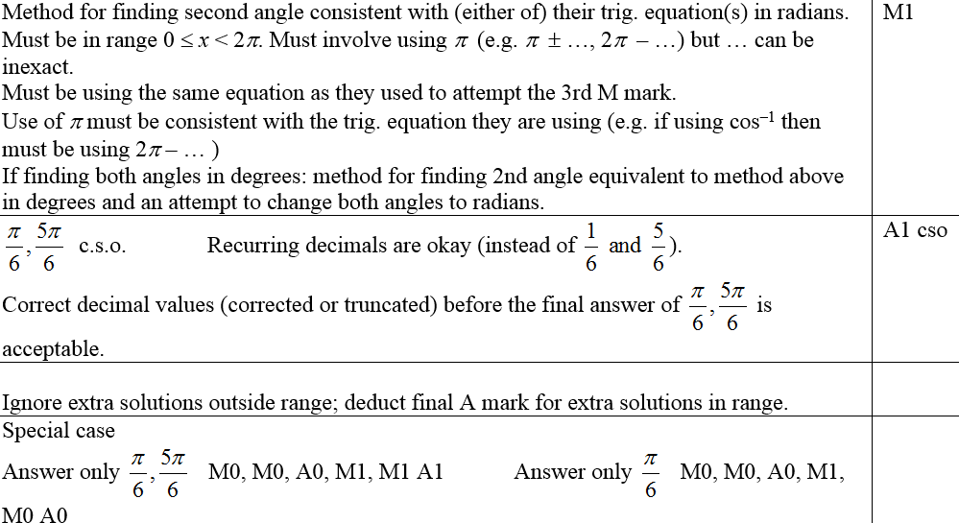
Jan 2007
Notes (last 2 marks and in general)

Slide 52
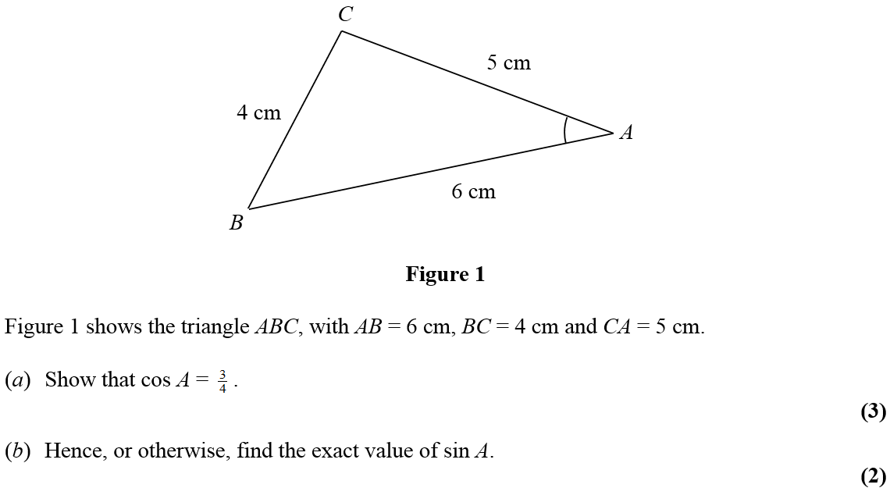
May 2007

Slide 53

May 2007
A
B

Slide 54

May 2007
A notes
B notes

Slide 55

May 2007

Slide 56

May 2007
A
B
C

Slide 57

May 2007
B notes
C notes

Slide 58

Jan 2008

Slide 59

Jan 2008
A
B

Slide 60

A notes
Jan 2008
B notes

Slide 61


Jan 2008

Slide 62

Jan 2008
A
B

Slide 63

A notes
Jan 2008
B notes (several other methods)

Slide 64

June 2008

Slide 65

June 2008
A
B

Slide 66

Jan 2009

Slide 67

Jan 2009
A
B
A notes
B notes
Special case for B

Slide 68

June 2009

Slide 69

June 2009
(i)
(ii)

Slide 70

Jan 2010

Slide 71

Jan 2010
A
B

Slide 72

Jan 2010
A
B

Slide 73


June 2010

Slide 74

June 2010
A
B

Slide 75

Jan 2011

Slide 76

Jan 2011
A
B

Slide 77

Jan 2011
A
B

Slide 78

May 2011

Slide 79



May 2011
A
B

Slide 80

May 2011
A

Slide 81


May 2011
B

Slide 82

Jan 2012

Slide 83



i
Jan 2012
ii
Alternative Method

Slide 84


Jan 2012
i
ii

Slide 85


May 2012

Slide 86

May 2012
A
B

Slide 87

May 2012
A
B

Slide 88

Jan 2013

Slide 89

Jan 2013
A

Slide 90

May 2013

Slide 91

May 2013
i
ii (a)
ii (b)

Slide 92
Logarithms
Jan 2010
May 2006
June 2010
Jan 2007
Jan 2011
May 2007
May 2011
Jan 2008
Jan 2012
June 2008
May 2012
Jan 2009
Jan 2013
June 2009
May 2013

Slide 93

May 2006

Slide 94

May 2006
i
ii

Slide 95
Jan 2007

Slide 96



Jan 2007
A
Notes
Possible Ans

Slide 97

May 2007

Slide 98


May 2007
A
B
A notes

Slide 99

May 2007
B notes

Slide 100


Jan 2008

Slide 101

Jan 2008
Method 1
Method 2

Slide 102

Notes
Jan 2008

Slide 103

June 2008

Slide 104


June 2008
A
B

Slide 105


Jan 2009

Slide 106

Jan 2009
A
Notes

Slide 107

Jan 2009
Alternative Methods
Special Cases

Slide 108

June 2009

Slide 109

June 2009
A
B

Slide 110

Jan 2010

Slide 111


Jan 2010
A
B
Alternative A

Slide 112

Jan 2010
A
B

Slide 113

June 2010

Slide 114

June 2010
A
B

Slide 115

Jan 2011

Slide 116

Jan 2011
A
B

Slide 117


Jan 2011
A
B

Slide 118

May 2011

Slide 119

May 2011
A
B

Slide 120

May 2011
A
B

Slide 121

Jan 2012

Slide 122


Jan 2012
A
B
A
B
B

Slide 123

May 2012

Slide 124

May 2012
A
Notes

Slide 125

May 2012
Alternative Method
Common Slips
Special Case

Slide 126

Jan 2013

Slide 127

Jan 2013
A
B

Slide 128

May 2013

Slide 129

May 2013
i
ii

Slide 130
Differentiation
Jan 2006
Jan 2010
May 2006
June 2010 (i)
Jan 2007 (i)
June 2010 (ii)
Jan 2007 (ii)
Jan 2011
May 2007
May 2011
Jan 2008
Jan 2012
June 2008
May 2012
Jan 2009
Jan 2013
June 2009
May 2013

Slide 131

Jan 2006

Slide 132

Jan 2006
A
B
C
D

Slide 133



May 2006

Slide 134

May 2006
A
B
C
D

Slide 135

Jan 2007

Slide 136




Jan 2007
A
B
A notes

Slide 137

Jan 2007
B notes

Slide 138

Jan 2007

Slide 139

Jan 2007
A
B
C

Slide 140




Jan 2007
A notes
A trial and improvement
A graph

Slide 141


Jan 2007
B notes
C notes

Slide 142


May 2007

Slide 143


May 2007
A
B
C
A notes

Slide 144

May 2007
B notes
C notes

Slide 145


Jan 2008

Slide 146


Jan 2008
A
B
C
D

Slide 147

Jan 2008
A
B
C

Slide 148


June 2008

Slide 149

June 2008
A
B

Slide 150

Jan 2009

Slide 151


Jan 2009
A
B
C
Other methods for C

Slide 152



Jan 2009
Alternative A
A notes
B notes
C notes

Slide 153


June 2009

Slide 154

June 2009
A
B
C
D

Slide 155

Jan 2010

Slide 156

Jan 2010
A
B
C

Slide 157

Jan 2010
A
B
C

Slide 158

June 2010

Slide 159

June 2010
A
B

Slide 160


June 2010

Slide 161

June 2010
A
B

Slide 162

Jan 2011

Slide 163

Jan 2011
A
B
C

Slide 164


Jan 2011
A
B
C

Slide 165


May 2011

Slide 166

May 2011
A
B
C

Slide 167

May 2011
A
B
C

Slide 168

Jan 2012

Slide 169

A
Jan 2012
B
C
D

Slide 170

Jan 2012
A
B
C
D

Slide 171

May 2012

Slide 172

A
May 2012
B
C
D
E

Slide 173

May 2012
A
B
C
D
E

Slide 174

Jan 2013

Slide 175


Jan 2013
A
B
C
D

Slide 176

May 2013

Slide 177

May 2013
A
B

Slide 178
Integration
Jan 2006 (i)
Jan 2006 (ii)
Jan 2008
June 2010 (i)
Jan 2013
May 2006 (i)
June 2008 (i)
June 2010 (ii)
May 2013 (i)
May 2006 (ii)
June 2008 (ii)
Jan 2011 (i)
May 2013 (ii)
May 2006 (iii)
Jan 2009 (i)
Jan 2011 (ii)
Jan 2007 (i)
Jan 2009 (ii)
May 2011
Jan 2007 (ii)
June 2009 (i)
Jan 2012
May 2007 (i)
June 2009 (ii)
May 2012 (i)
May 2007 (ii)
Jan 2010
May 2012 (ii)

Slide 179

Jan 2006

Slide 180

Jan 2006
A
B

Slide 181

Jan 2006

Slide 182

Jan 2006
A
B

Slide 183

May 2006

Slide 184

May 2006
A

Slide 185

May 2006

Slide 186

May 2006
A
B
C

Slide 187
May 2006

Slide 188
May 2006
A
B
C
D

Slide 189
Jan 2007

Slide 190
Jan 2007
A
B
A notes

Slide 191
Jan 2007
B notes

Slide 192


Jan 2007

Slide 193



Jan 2007
A
Notes for first 4 marks

Slide 194

Jan 2007
Notes for last 5 marks

Slide 195

May 2007

Slide 196

May 2007
A

Slide 197

May 2007
A notes

Slide 198



May 2007

Slide 199

May 2007
A
B
C

Slide 200

May 2007
A notes
B notes
C notes

Slide 201


Jan 2008

Slide 202

Jan 2008
A
B
C

Slide 203

Jan 2008
B notes
C notes and alternative method

Slide 204

June 2008

Slide 205

June 2008
A
B

Slide 206
June 2008

Slide 207
June 2008
A
B

Slide 208


Jan 2009

Slide 209


A
Jan 2009
Notes
Special Cases

Slide 210

Jan 2009

Slide 211


Jan 2009
A
B
A notes
B notes
Special Cases

Slide 212

June 2009

Slide 213

June 2009
A

Slide 214




June 2009

Slide 215

June 2009
A
B
C

Slide 216


Jan 2010

Slide 217


Jan 2010
A
B
C
D
Alternative D (i)

Slide 218


Jan 2010
A
B
C
D
Alternative D (ii)
Alternative D (iii)

Slide 219

June 2010

Slide 220

June 2010
A
B

Slide 221
June 2010

Slide 222
June 2010
A
B

Slide 223


Jan 2011

Slide 224

Jan 2011
A
B

Slide 225

Jan 2011
A
B

Slide 226



Jan 2011

Slide 227

Jan 2011
A
B
C

Slide 228

Jan 2011
B
C

Slide 229

May 2011

Slide 230

May 2011
A
B

Slide 231

May 2011
A
B

Slide 232

May 2011
Alternative B

Slide 233

May 2011
Notes on Alternative B

Slide 234

May 2011
2 more methods for B

Slide 235



Jan 2012

Slide 236

Jan 2012
A
B
C

Slide 237

Jan 2012
A
B
C
B

Slide 238


May 2012

Slide 239

May 2012
A
Method 1
B

Slide 240

May 2012
Method 1
Notes
A
B

Slide 241


May 2012
B
Method 2
Special case for above method

Slide 242

May 2012
Method 2
Special Case 2
Notes
Notes

Slide 243

May 2012

Slide 244


May 2012
A
B
A
B

Slide 245


Jan 2013

Slide 246

Jan 2013
A
B
C

Slide 247


May 2013

Slide 248

May 2013
A
B
C

Slide 249

May 2013

Slide 250

May 2013
A
B

Slide 251
Factors
Jan 2006
Jan 2010
May 2006
June 2010
Jan 2007
Jan 2011
May 2007
May 2011
Jan 2008
Jan 2012
June 2008
May 2012
Jan 2009
Jan 2013
June 2009
May 2013

Slide 252

Jan 2006

Slide 253

Jan 2006
A
B
C

Slide 254

May 2006

Slide 255


May 2006
A
B
C
A
B

Slide 256

May 2006
C

Slide 257

Jan 2007

Slide 258


Jan 2007
A
B
C
A notes

Slide 259


Jan 2007
B notes (i)
B notes (comparing coefficents)

Slide 260

Jan 2007
B notes (factor theorem)
C notes

Slide 261

May 2007

Slide 262


May 2007
A
B
A notes

Slide 263

May 2007
B notes

Slide 264

Jan 2008

Slide 265


Jan 2008
A (i)
A (ii)
B
A notes

Slide 266

Jan 2008
B

Slide 267

June 2008

Slide 268

June 2008
A
B

Slide 269

Jan 2009

Slide 270

Jan 2009
A
B
Alternative A
Alternative B

Slide 271

Jan 2009
A notes
B notes
Alternative A
Alternative B
Beware

Slide 272

June 2009

Slide 273

June 2009
A
B
C

Slide 274

Jan 2010

Slide 275


Jan 2010
A
B
Alternative A
Alternative B

Slide 276

Jan 2010
A
B

Slide 277

June 2010

Slide 278

June 2010
A
B

Slide 279

Jan 2011

Slide 280

Jan 2011
A
B

Slide 281

Jan 2011
A
B
A (long division)
B (long division)

Slide 282

May 2011

Slide 283


May 2011
A
B
C
A
B

Slide 284


May 2011
C

Slide 285


Jan 2012

Slide 286


Jan 2012
A
B
Long Division

Slide 287

Jan 2012
A
B

Slide 288

May 2012

Slide 289


May 2012
A
B
A
B

Slide 290

Jan 2013

Slide 291

Jan 2013
A
B

Slide 292

May 2013

Slide 293

May 2013
A
B
C

Slide 294
Geometric Sequences and Series
Jan 2006
Jan 2010
May 2006
June 2010
Jan 2007
Jan 2011
May 2007
May 2011
Jan 2008
Jan 2012
June 2008
May 2012
Jan 2009
Jan 2013
June 2009
May 2013

Slide 295

Jan 2006

Slide 296

A
Jan 2006
B
C
D

Slide 297

May 2006

Slide 298

May 2006
A
B
C
D
E

Slide 299

Jan 2007

Slide 300

Jan 2007
A
B
C
D

Slide 301


Jan 2007
A
A slight alternate

Slide 302


Jan 2007
B
Alternative B (adding 10 terms)

Slide 303

Jan 2007
C
D

Slide 304

May 2007

Slide 305

May 2007
A
B
C
D

Slide 306

May 2007
B notes
C notes
D notes

Slide 307

Jan 2008

Slide 308

Jan 2008
A
B
C
A notes
B notes
C notes

Slide 309

June 2008

Slide 310

June 2008
A
B
C
D

Slide 311

Jan 2009

Slide 312

Jan 2009
A
B
C
D

Slide 313

Jan 2009
A notes
B notes
C notes
D notes

Slide 314

June 2009

Slide 315

June 2009
A
B
C
D

Slide 316

Jan 2010

Slide 317


Jan 2010
A
B
C
D
Alternative B
Alternative C
Alternative D

Slide 318

Jan 2010
A
B
C
D

Slide 319

June 2010

Slide 320

June 2010
A
B
C
D
E

Slide 321

Jan 2011

Slide 322

Jan 2011
A
B
C

Slide 323

Jan 2011
A
B
C

Slide 324

May 2011

Slide 325

A
May 2011
B
C
D

Slide 326

May 2011
A
B

Slide 327

C
May 2011
D

Slide 328

May 2011
D…

Slide 329

Jan 2012

Slide 330


Jan 2012
A
B
C
A
B
C
A
B

Slide 331

May 2012

Slide 332

May 2012
A
B
C
D

Slide 333

May 2012
A
B
C
D
COMMON ERRORS

Slide 334

Jan 2013

Slide 335

Jan 2013
A
B
C

Slide 336

May 2013

Slide 337

May 2013
A
B
C

Slide 338
Radians
Jan 2006
Jan 2010
May 2006
June 2010
Jan 2007
Jan 2011
May 2007
May 2011
Jan 2008
Jan 2012
June 2008
May 2012
Jan 2009
Jan 2013
June 2009
May 2013

Slide 339

Jan 2006

Slide 340

Jan 2006
A
B
C
D

Slide 341


May 2006

Slide 342

May 2006
A
B
C
D

Slide 343


Jan 2007

Slide 344

Jan 2007
A
B
C
D
E

Slide 345


Jan 2007
A
A alternative

Slide 346


Jan 2007
B
C

Slide 347

Jan 2007
Alternative C
D
E

Slide 348
May 2007

Slide 349
May 2007
A
B
C

Slide 350
May 2007
B notes
C notes

Slide 351


Jan 2008

Slide 352


A
Jan 2008
B
C

Slide 353

Jan 2008
A notes
B notes
C notes

Slide 354


June 2008

Slide 355

June 2008
A
B
C
D

Slide 356


Jan 2009

Slide 357

A
Jan 2009
B
C
A notes
B notes
C notes

Slide 358
June 2009

Slide 359
June 2009
A
B
C
D

Slide 360


Jan 2010

Slide 361

Jan 2010
A
B

Slide 362


Jan 2010
A
B
Special Case A

Slide 363


June 2010

Slide 364

June 2010
A
B
C
D

Slide 365

Jan 2011

Slide 366

Jan 2011
A
B

Slide 367

Jan 2011
A
B

Slide 368


May 2011

Slide 369

May 2011
A
B
C
A

Slide 370

May 2011
B
C

Slide 371

Jan 2012

Slide 372

Jan 2012
A
B
C
D
E

Slide 373

Jan 2012
A
B
C
D
E
E

Slide 374


May 2012

Slide 375

May 2012
A
B
C
D

Slide 376

May 2012
A
B
C
A
B
D

Slide 377

Jan 2013

Slide 378

Jan 2013
A
B
C
D

Slide 379

May 2013

Slide 380

May 2013
A
B

Slide 381
Circles
Jan 2006
Jan 2010
May 2006
Jan 2011
Jan 2007
May 2011
May 2007
Jan 2012
June 2008
May 2012
Jan 2009
Jan 2013
June 2009
May 2013

Slide 382

Jan 2006

Slide 383

Jan 2006
A
B
C

Slide 384


May 2006

Slide 385

May 2006
A
B
C

Slide 386

Jan 2007

Slide 387


Jan 2007
A
Notes

Slide 388



May 2007

Slide 389

May 2007
A
B
C

Slide 390

May 2007
A notes
C notes

Slide 391

June 2008

Slide 392

June 2008
A
B

Slide 393


Jan 2009

Slide 394

Jan 2009
A
B
Alternative A
Alternative B

Slide 395

Jan 2009
Further Alternatives

Slide 396

Jan 2009
A notes
B notes

Slide 397

June 2009

Slide 398

June 2009
A
B
C

Slide 399


Jan 2010

Slide 400

Jan 2010
A
B
C
D
E

Slide 401

Jan 2010
A
B
C
D
E

Slide 402

Jan 2011

Slide 403

Jan 2011
A
B
C
D

Slide 404


Jan 2011
A
B
C
D

Slide 405

May 2011

Slide 406

May 2011
A
B
C

Slide 407

May 2011
A
B
C

Slide 408
Jan 2012

Slide 409

Jan 2012
A
Notes
Alternative Method

Slide 410
May 2012

Slide 411
May 2012
A
B
C
D

Slide 412
May 2012
A
B
C
A
B
D

Slide 413

Jan 2013

Slide 414

A (i)
Jan 2013
A (ii)
B
C

Slide 415

May 2013

Slide 416

May 2013
A
B

Slide 417


