Slide 2
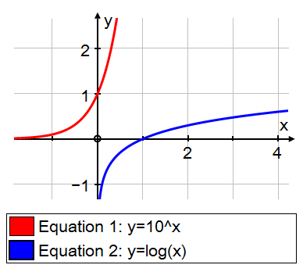
AS Core Maths - TAM Online Session 11: Exponentials & Natural Logarithms
Whilst you’re waiting,
tell each other what
you remember
about logarithms

Slide 3
Session content
Finding a value for e
The exponential function
The natural logarithm function
This is a content based on chapter 2 in the A2 core textbook, and a bit of chapter 4

Slide 4

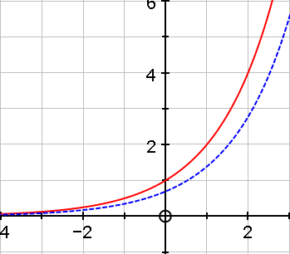
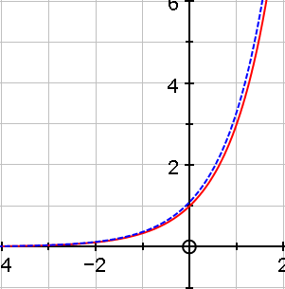


Gradient functions
$$y=2^{x}$$
$$y=3^{x}$$

Slide 5

Very Important Results
Notes:
Interesting sequences? Tarsia doc?

Slide 6
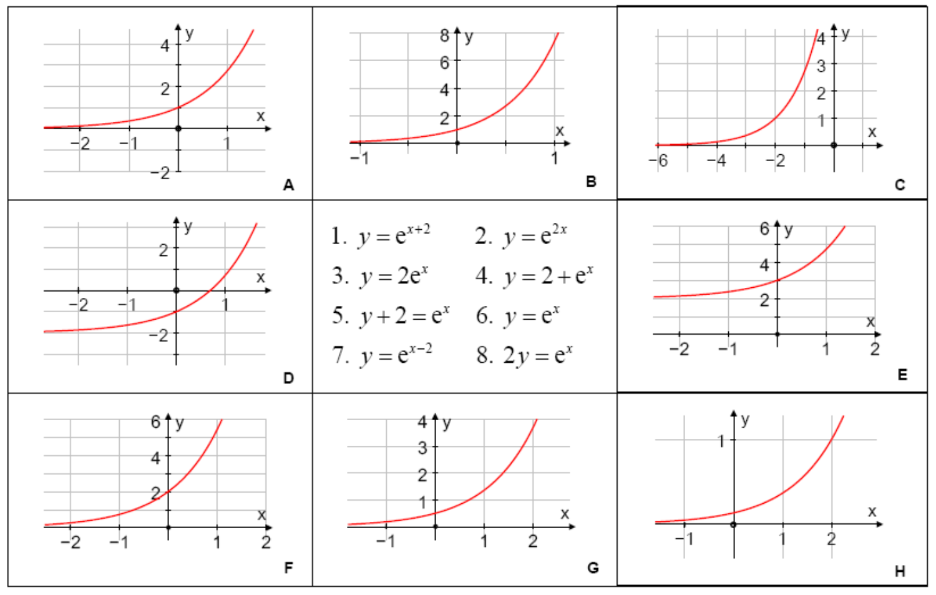
Matching activity
Notes:
Interesting sequences? Tarsia doc?

Slide 7
e^{x} as an infinite series (extension but all A level Maths teachers should know this!)
x | x! | 1/x! | sum of 1/x!
0 | 1 | 1.0000000000 | 1.0000000000
1 | 1 | 1.0000000000 | 2.0000000000
2 | 2 | 0.5000000000 | 2.5000000000
3 | 6 | 0.1666666667 | 2.6666666667
4 | 24 | 0.0416666667 | 2.7083333333
5 | 120 | 0.0083333333 | 2.7166666667
6 | 720 | 0.0013888889 | 2.7180555556
7 | 5040 | 0.0001984127 | 2.7182539683
8 | 40320 | 0.0000248016 | 2.7182787698
9 | 362880 | 0.0000027557 | 2.7182815256
10 | 3628800 | 0.0000002756 | 2.7182818011
Notes:
Interesting sequences? Tarsia doc?

Slide 8
Now for an unrelated(?) idea…
Notes:
Interesting sequences? Tarsia doc?

Slide 9
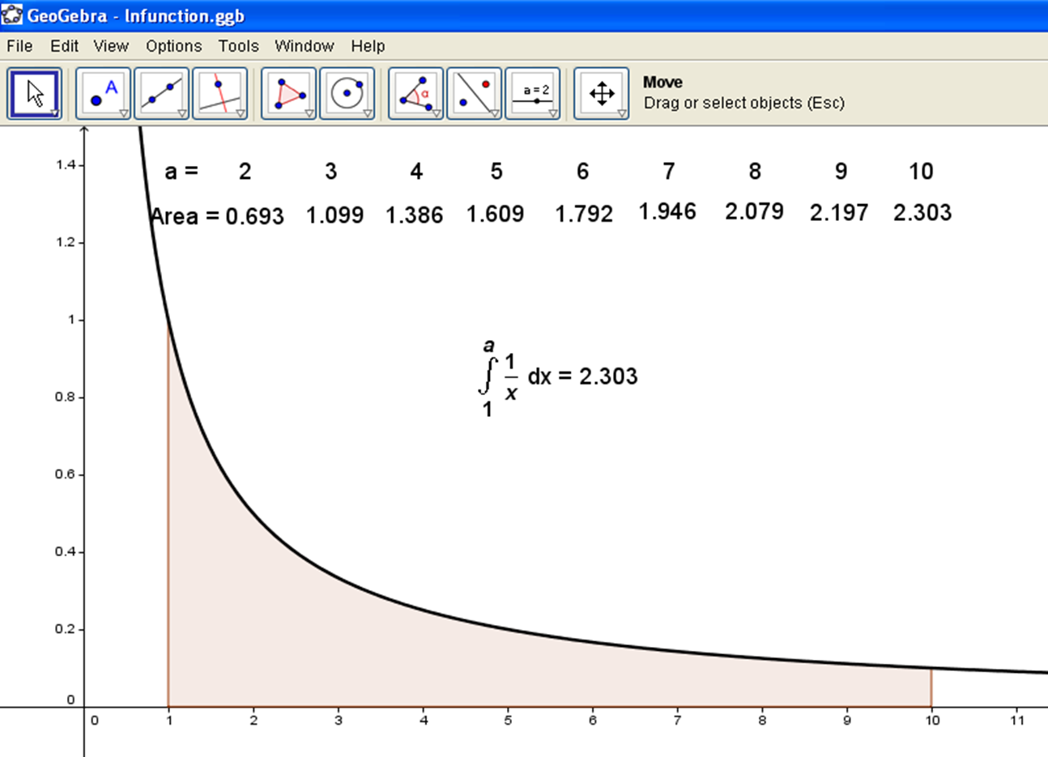

Area under curve $y=\frac{1}{x}$
Notes:
Interesting sequences? Tarsia doc?

Slide 10
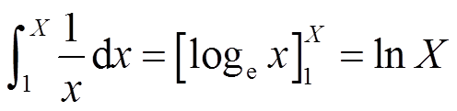
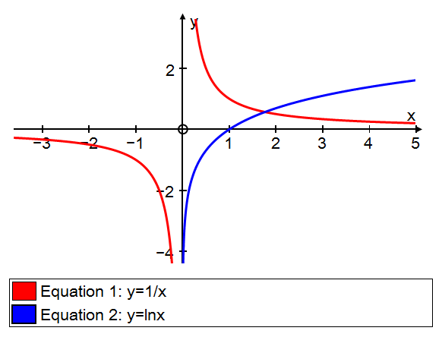
Notes:
Interesting sequences? Tarsia doc?

Slide 11
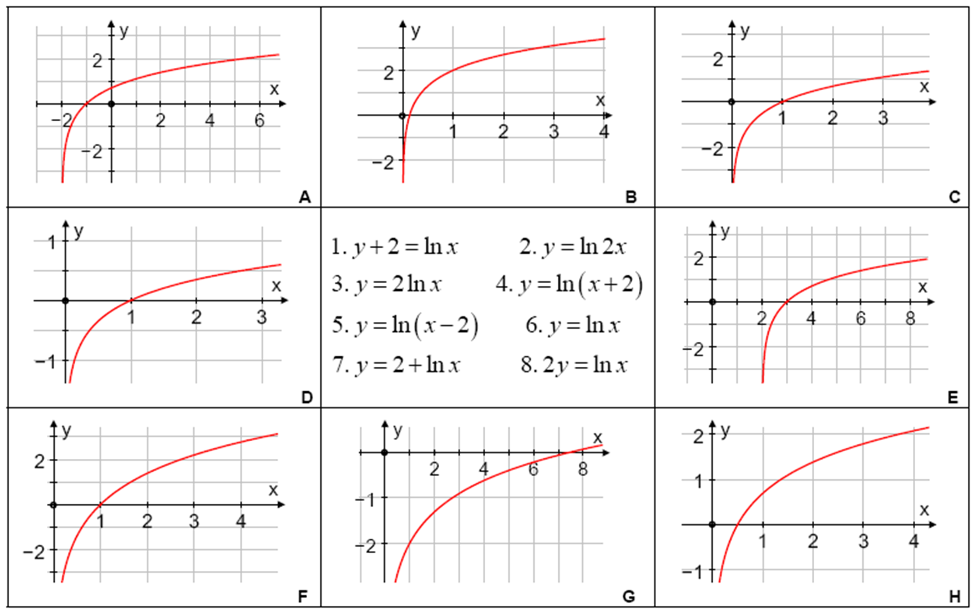
Matching activity
Notes:
Interesting sequences? Tarsia doc?

Slide 12
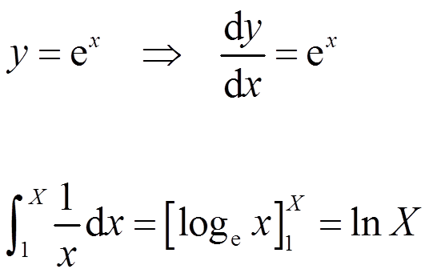
Summary
Notes:
Interesting sequences? Tarsia doc?

Slide 13
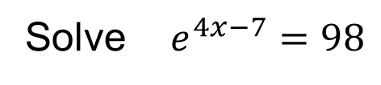
Solving equations
Notes:
Interesting sequences? Tarsia doc?

Slide 14
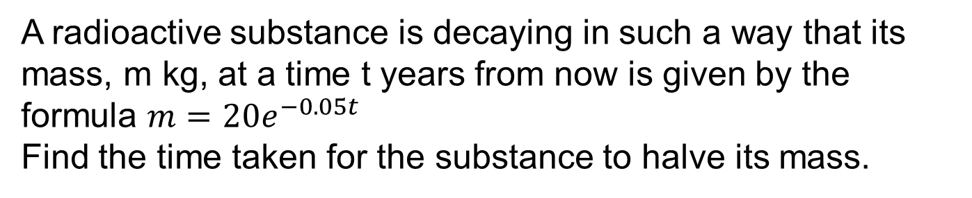
Exponential growth & decay
Notes:
Interesting sequences? Tarsia doc?

Slide 15
Session content check
Finding a value for e
The exponential function
The natural logarithm function
Notes:
Interesting sequences? Tarsia doc?

Slide 16
MEI Core 3 Jan 11 - Q5 [8 marks]
Notes:
Interesting sequences? Tarsia doc?

Slide 17
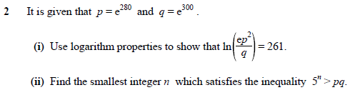
OCR Core 3 Jun 12 – Q2 [6 marks]

Slide 18
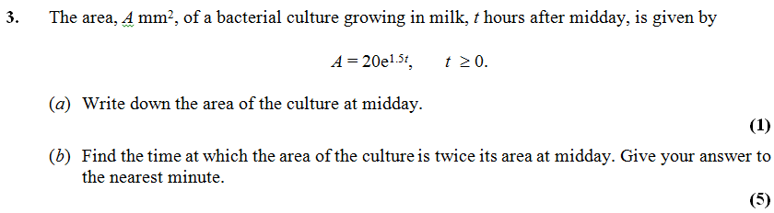
EXEXCEL Core 3 Jan 12 – Q3 [6 marks]

Slide 19
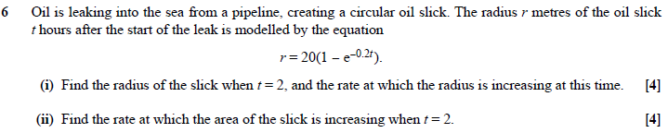
MEI Core 3 Jan 12 – Q6 [8 marks]

Slide 20
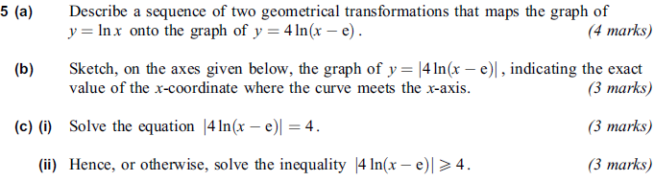
AQA Core 3 Jan 12 – Q5 [13 marks marks]

