Slide 1
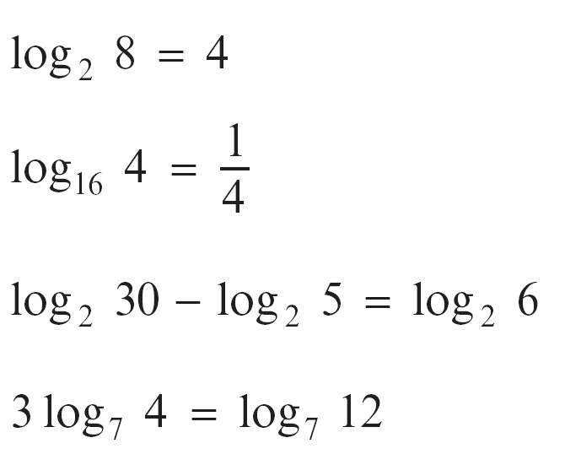
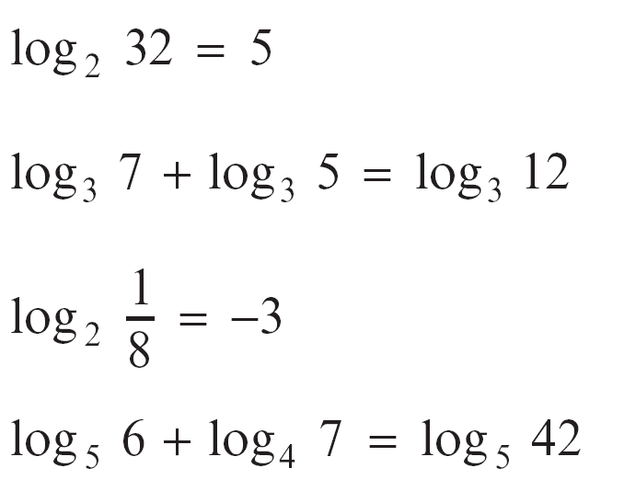
Logarithms
1.
2.
3.
4.
5.
6.
7.
8.
I scored 3 out of 8 in my logarithms test but which three did I get correct?

