Slide 1
Core 1 Polynomials Dividing polynomials, Factor Theorem and Remainder Theorem. Binomial Expansion
Since we’ll be talking about factorials (5! = 1×2×3×4×5 = 120) in the binomial expansion, a question to think about before we start:
How many zeros are there after the last non-zero digit in 100! ?

Slide 2
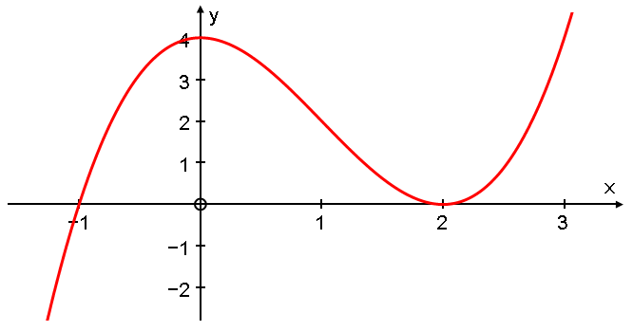
Polynomial division
Factor Theorem Remainder Theorem

Slide 3
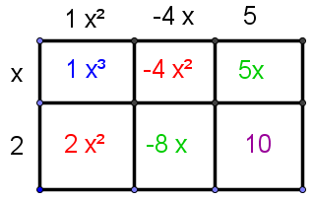
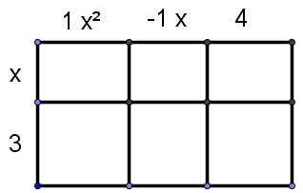
Polynomial multiplication

Slide 4
Polynomial division

Slide 5
Polynomial division

Slide 6
Two to try

Slide 7
Polynomial division
Factor Theorem Remainder Theorem

Slide 8
Factor Theorem
If (x-a) is a factor of f(x),
then f(a)=0 and x=a is a root of the equation f(x)=0.
Conversely, if f(a)=0 then (x-a) is a factor of f(x).

Slide 9
Remainder Theorem
For a polynomial f(x),
f(a) is the remainder when f(x) is divided by (x-a).

Slide 10
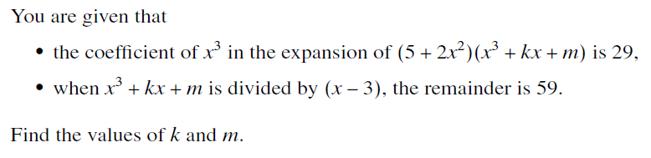
MEI Core 1, June 10, Qn 6, 5 marks
MEI Core 1, June 09, Qn 3, 3 marks

Slide 11
Binomial Expansion

Slide 12
Magic?
1
1 1
1 2 1
1 3 3 1
1 4 6 4 1

Slide 13
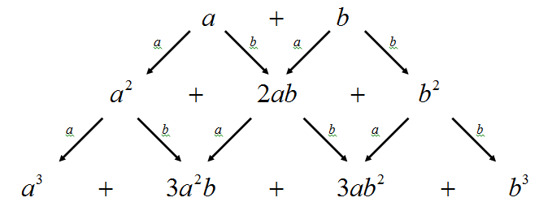
Why Pascal’s triangle gives the binomial coefficients

Slide 14
The problem with relying on Pascal’s triangle
How would you find the coefficient of x⁷ in the expansion of

Slide 15
Pascal’s Triangle isn’t really about adding numbers – it’s about choosing.
1
1 1
1 2 1
1 3 3 1
1 4 6 4 1
1 5 10 10 5 1

Slide 17
Binomial Expansion

Slide 18

MEI Core 1, Jan 10, Qn 8, 4 marks

Slide 19
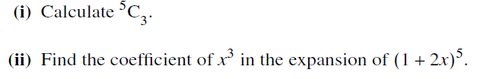
MEI Core 1, June 09, Qn 5, 4 marks

Slide 20
MEI Core 1, Jan 08, Qn 7, 4 marks

Slide 21
Two much more challenging questions involving ^{n}C_{r}
How many anagrams of ANAGRAM do not contain adjacent As?
How many ways are there of writing 20 as a sum of exactly 4 positive integers where order matters? (3+8+8+1 is different from 1+3+8+8)

