Slide 1
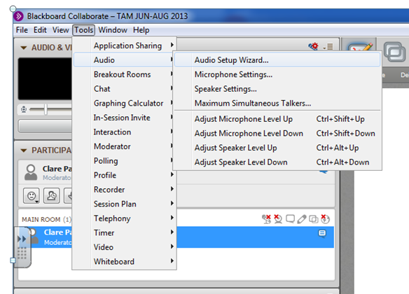
Just arrived? Go to ‘Audio Setup’

Slide 2
AS Core Maths-TAM Online Session 4 : Indices, Surds & the language of maths
A warm up question to look at while you are waiting:

Slide 3
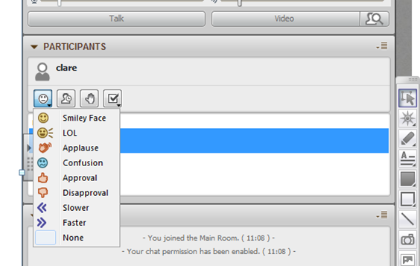




This menu is the quickest way to communicate:
Emotions – give immediate feedback
Time out – it’s polite to tell everyone else if you are leaving the room for a bit
Raise your hand to attract attention.
Respond to a question or take part in a poll.

Slide 4
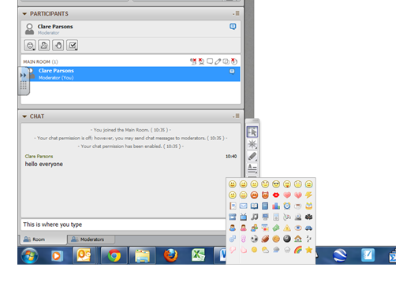
This is the chat box where you can type a message, then either click on “Send” or just press ‘return’ on your keyboard.
A very extensive emotions menu is found by clicking on the smiley face at the end of this box.
You can write on the whiteboard by:
using a pen or mouse
typing in text box

Slide 5
Session Content
Indices
Surds
Language of Mathematics
Proof
NB: This is content based on chapters 5 & 6in the AS Core textbook

Slide 6





Types of Numbers
$$ℕ$$
$$ℤ$$
$$ℚ$$
$$ℝ$$
$$ℂ$$

Slide 7
Approximating √2

Slide 8
Proof that√2 is irrational

Slide 9

Simplifying surds - why bother?
How would you work out, by hand, ?
How would you simplify ?

Slide 10
Operations on surds

Slide 11
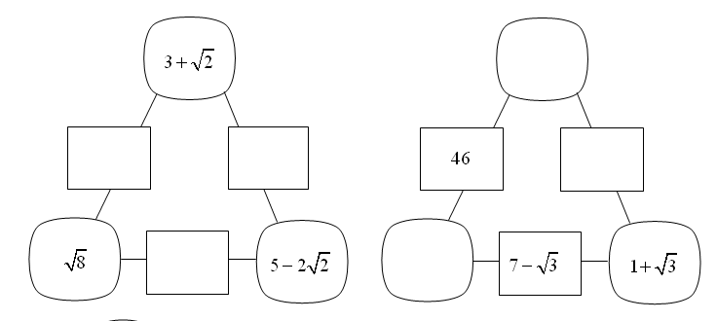

Slide 12
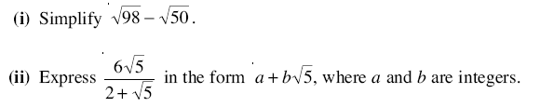
MEI Core 1, June 07, Qn 8, 5 marks

Slide 13

What is the exact value of

Slide 14
Rules for positive integer indices

Slide 15
What if…? Negative and fractional indices

Slide 16

$${16}^{\frac{1}{4}}$$
$${100}^{−\frac{1}{2}}$$
$${343}^{−\frac{2}{3}}$$

Slide 17
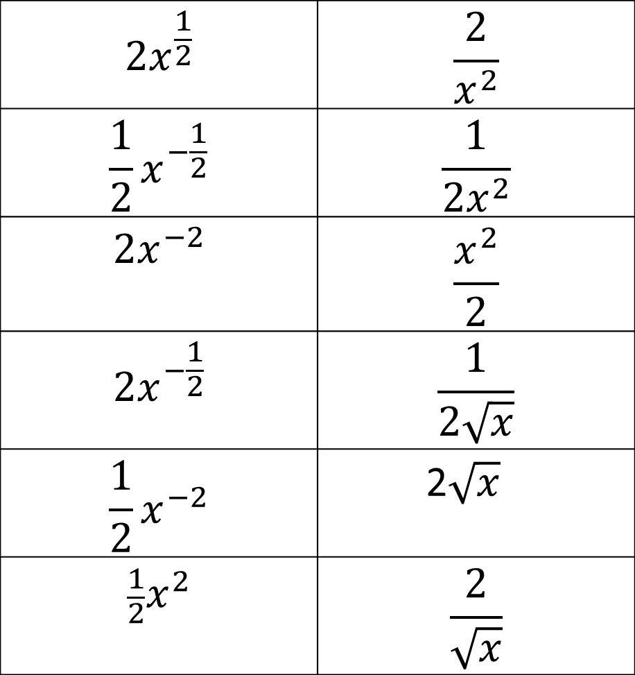
$$2x^{\frac{1}{2}}$$ | $$\frac{2}{x^{2}}$$
$$\frac{1}{2}x^{−\frac{1}{2}}$$ | $$\frac{1}{2x^{2}}$$
$$2x^{−2}$$ | $$\frac{x^{2}}{2}$$
$$2x^{−\frac{1}{2}}$$ | $$\frac{1}{2\sqrt{x}}$$
$$\frac{1}{2}x^{−2}$$ | 2$\sqrt{x}$
$$\frac{1}{2}x^{2}$$ | $$\frac{2}{\sqrt{x}}$$

Slide 18
The Language of Mathematics chapter toys with proof but the topic isn’t treated seriously until Core 3 (and the September on line session). Nevertheless…

Slide 19

Proving statements about positive integers
n is a positive integer.
Prove that is always an integer.

Slide 20
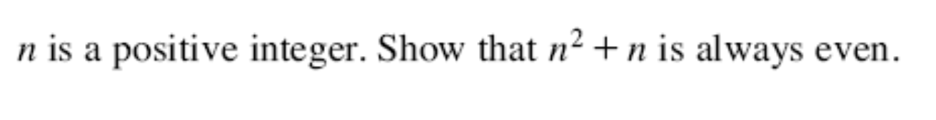
MEI Core 1, Jan 06, Qn 1, 2 marks

Slide 21
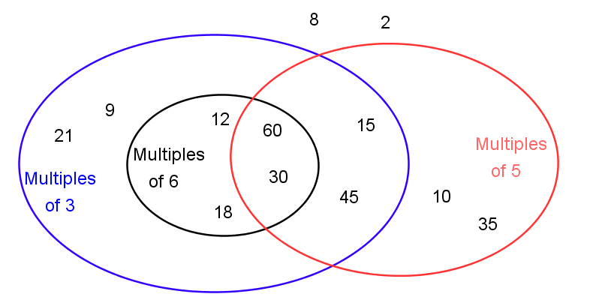
If a number is a multiple of 6 then it is a multiple of 3.
A sufficient condition for a number to be a multiple of 3 is that it is a multiple of 6 but this is not necessary.
n is a multiple of 6  n is a multiple of 3
“implies”

Slide 22
A necessary condition for a number to be a multiple of 6 is that it is a multiple of 3 but this is not sufficient.
n is a multiple of 3  n is a multiple of 6
“is implied by”

Slide 23
A necessary and sufficient condition for a number to be a multiple of 30 is that it is a multiple of 5 and a multiple of 6.
n is a multiple of 30  n is a multiple of 5 and of 6.
“if and only if”

Slide 24
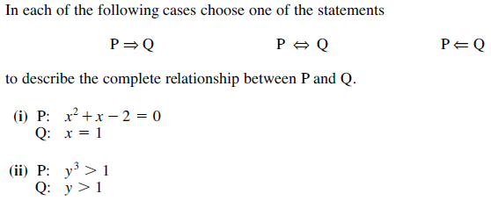
MEI Core 1, June 06, Qn 4, 2 marks

Slide 25
Session content check
Indices
Surds
Language of Mathematics
Proof

Slide 26
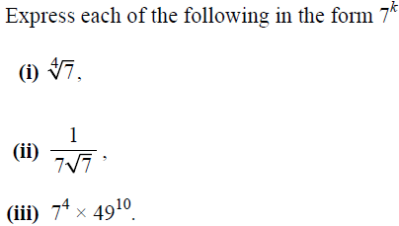
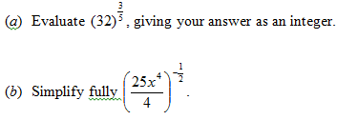
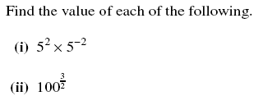
OCR Core 1, May 12, Qn 2, 5 marks
MEI Core 1, May 09, Qn 7, 3 marks
EDEXCEL Core 1, May 12,
Qn 2, 4 marks
EDEXCEL Core 1, Jan13,
Qn 2, 2 marks
Express 8^{2x + 3} in the form 2^{y},
stating y in terms of x.

Slide 27
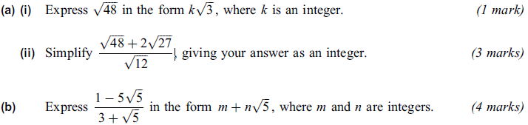
AQA Core1 May11 Qn1, 2 marks

Slide 28
EDEXCEL Core 1, Jan13, Qn 3, 6 marks

Slide 29

MEI Core 1, Jun 10, Qn 9, 2 marks

Slide 30
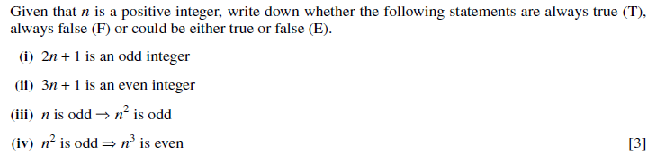
MEI Core 1, May 08, Qn 4, 3 marks

Slide 31
MEI Core 1, May 09, Qn 6, 3 marks

Slide 32

MEI Core 1, Jan 08, Qn 9, 5 marks

