Slide 2
AS Core Maths - TAM Online Session 6: Differentiation
Warm-up question:
Cut square corners from a 6 by 12 sheet and fold to make a box. What size of square corners would create the box with maximum volume?

Slide 3
Session content
Differentiation from first principles
Equations of tangents & normals
Stationary points
Optimisation problems
NB: This is content based on chapters 8 & 12 in the AS core textbook

Slide 4
The gradient of a line

Slide 5
Can we talk about the gradient of a curve?

Slide 6
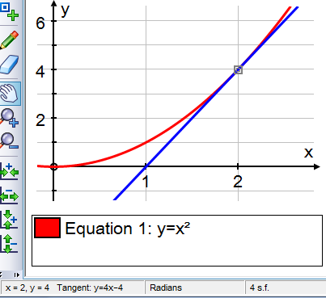
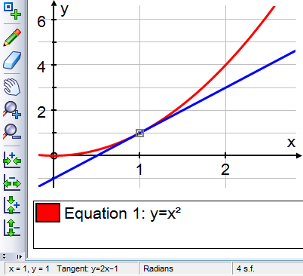

Tangents to $y=x^{2}$

Slide 7
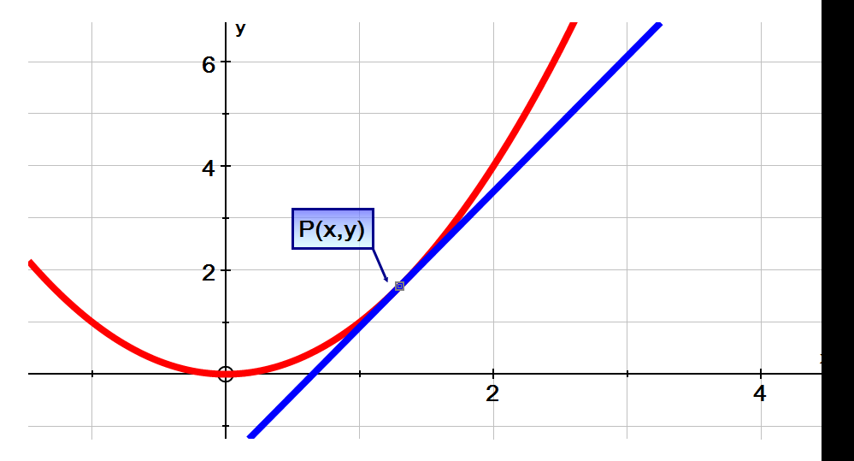
Tangents to $y=x^{2}$

Slide 9
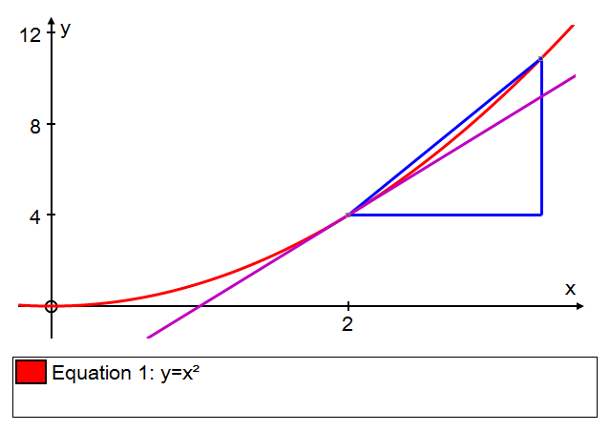

Slide 10
Differentiation from first principles (1)

Slide 11

Differentiation from first principles (2)
$$y=x^{3}$$

Slide 12
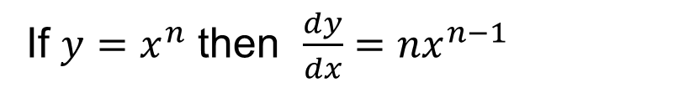
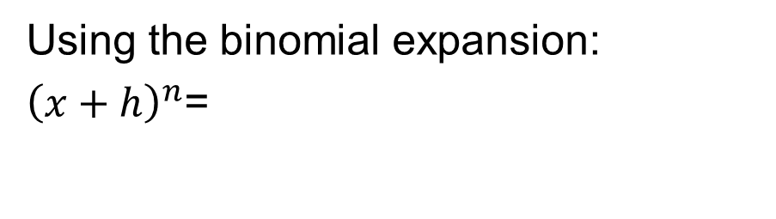
The general rule
If $y=x^{n}$ then $\frac{dy}{dx}={nx}^{n−1}$
Using the binomial expansion:
${\left(x+h\right)}^{n}$=

Slide 14
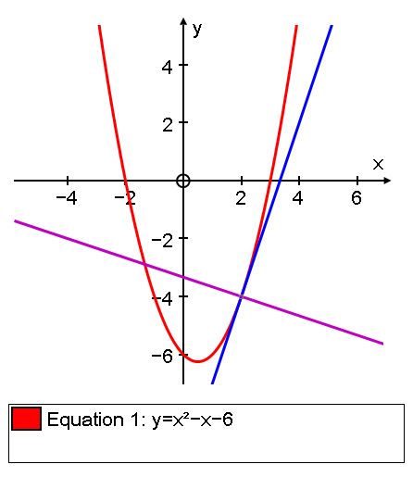
Tangents and normals

Slide 15
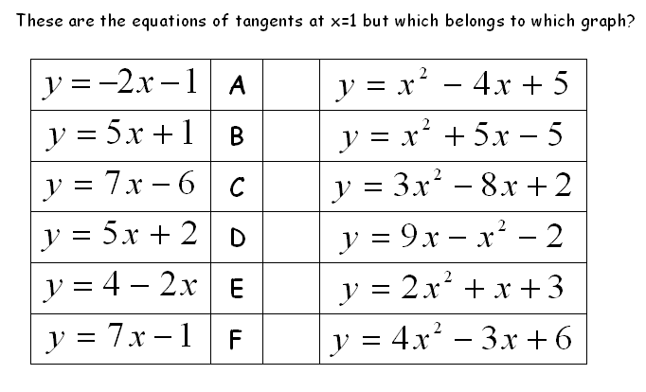

Slide 16
Stationary points

Slide 17
Second derivatives

Slide 18
Stationary points & turning points

Slide 19
An application of differentiation
Cut square corners from a 6 by 12 sheet and fold to make a box. What size square corners should you remove in order to create the box with maximum volume?

Slide 22
Session content check
Differentiation from first principles
Equations of tangents & normals
Stationary points
Optimisation problems

Slide 23

OCR Core 1 Jun 11 - Q8 [7 marks]

Slide 24
MEI Core 2 Jan 10 - Q8 [5 marks]

Slide 25
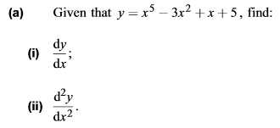
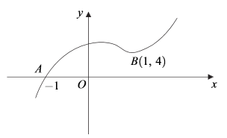

AQA Core 1 Jan 12 - Q4 (part) [9 marks]

Slide 26
MEI Core 2 Jun 09 - Q6 [5 marks]

Slide 27
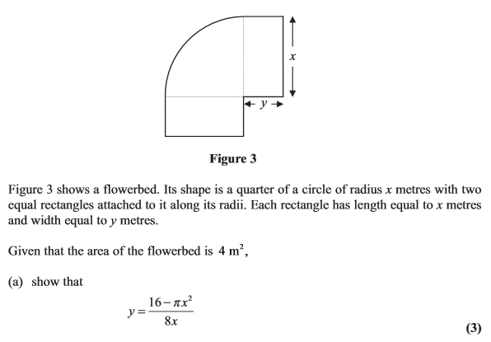
Edexcel Core 2 Jan 12 - Q8 [13 marks]
cont.

Slide 28
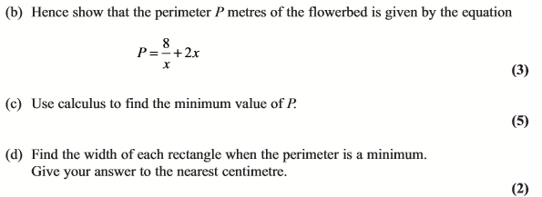
Edexcel Core 2 Jan 12 - Q8 [13 marks]

