Slide 1
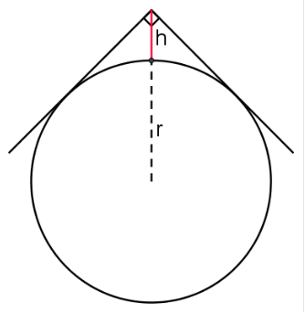
AS Core Maths-TAM Online Session 1: Basic Algebra and Uncertainty
A couple of warm-up questions before we get started…
1. A quadratic equation has roots
What could the equation be?
2. How can you find the radius of the pipe shown if the only measurement you can take is the one marked h?

Slide 2
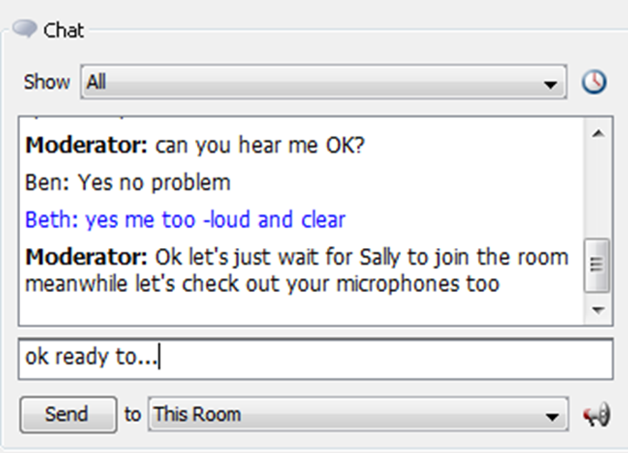


Welcome: Can you hear me?
Quick sound check…let’s communicate and chat…
Please type in the chat box to let me know if you can hear me or not..
This is the space (on the left of your screen) where you type your message, then either click on “Send” or just press ‘return’ on your keyboard.

Slide 3


Slide 4
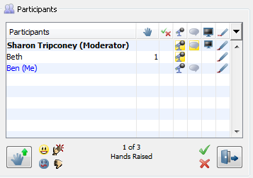
This shows you all the participants online. Try out the emoticons for instant / quick responses. You can even put your ‘hand up’!
Select ‘yes’ or ‘no’
Smile
Applause!
Hand up /down
Frown
Rubbish!
‘In or out' of the room
Notes:
‘Courtesy’ button - if need to pop out of room press this & then when return press again
‘Hand up/down’ – press to put hand down
Tick/Cross - need to unselect as well
Emoticons last for few seconds then disappear

Slide 5

Place a mark on the map
showing where you are

Slide 6
1. A quadratic equation has roots
What could the equation be?
2. How can you find the radius of the pipe shown if the only measurement you can take is the one marked h?

Slide 7
Session Content
Quadratic equations
- solving, representing, transformations
- completing the square
- discriminant
Simultaneous equations
Inequalities
NB: This is content based on chapters 1 & 4 in the AS Core textbook

Slide 8

Completing the square - Geogebra file

Slide 9
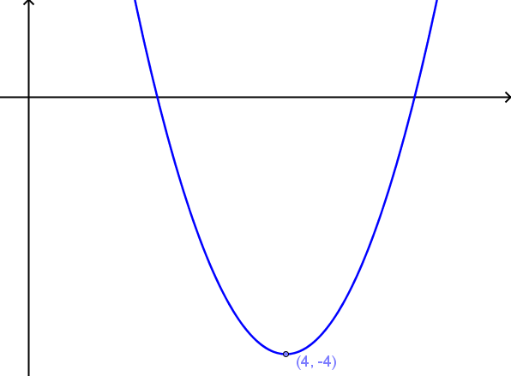
What could the equation be?

Slide 10
Given that the coefficient of x² is 2, what is the y-intercept?

Slide 11
Features of Completing the Square
Features of Completed the Square Form for a Quadratic

Slide 12

Proving the Quadratic Formula
$$If ax^{2}+bx+c=0 then x=\frac{−b±\sqrt{b^{2}−4ac}}{2a}$$

Slide 13
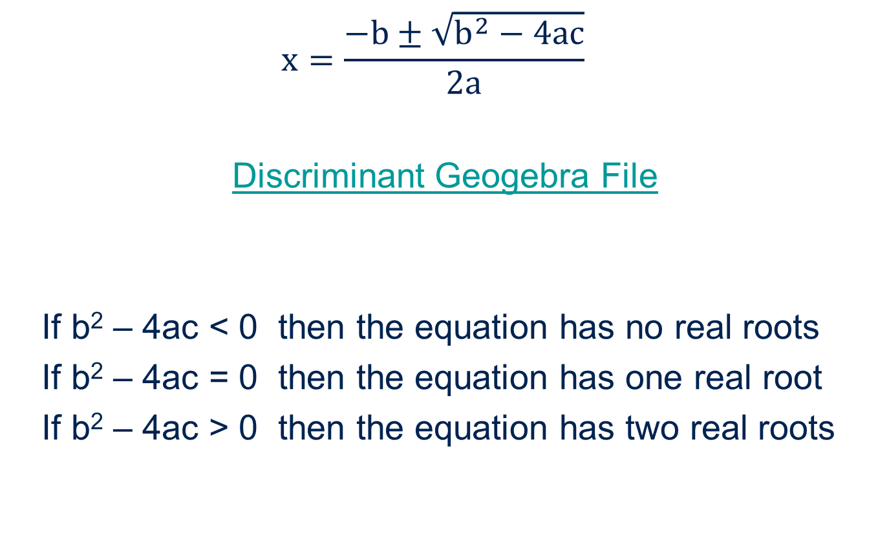
The Discriminant
$$x=\frac{−b±\sqrt{b^{2}−4ac}}{2a}$$
Discriminant Geogebra File
If b² – 4ac < 0 then the equation has no real roots
If b² – 4ac = 0 then the equation has one real root
If b² – 4ac > 0 then the equation has two real roots
;

Slide 14
Quadratic graphs & transformations

Slide 16
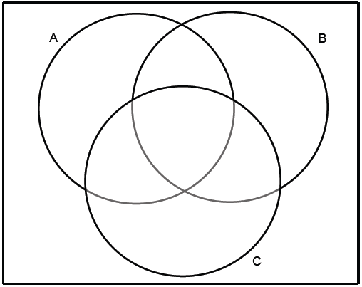


Slide 17
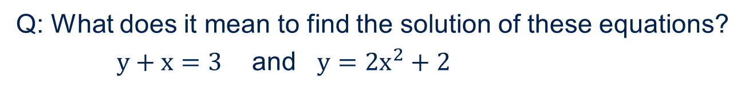
Simultaneous Equations
Q: What does it mean to find the solution of these equations?
$y+x=3$ and $y=2x^{2}+2$

Slide 18
Inequalities (1)
$$5x−3≤10−2\left(2−x\right)$$

Slide 19

Inequalities (2)
$$x^{2}+x>6$$

Slide 20

Inequalities (3)
$$x+1>\frac{6}{x}$$

Slide 21
Session content check
Quadratic equations
- solving, representing, transformations
- completing the square
- discriminants
Simultaneous equations
Inequalities

Slide 22
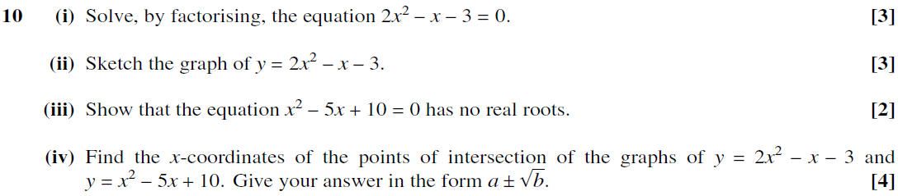
MEI C1 June 2010
    10.

Slide 23
EDEXCEL C1 JUNE 2013
10.

Slide 24
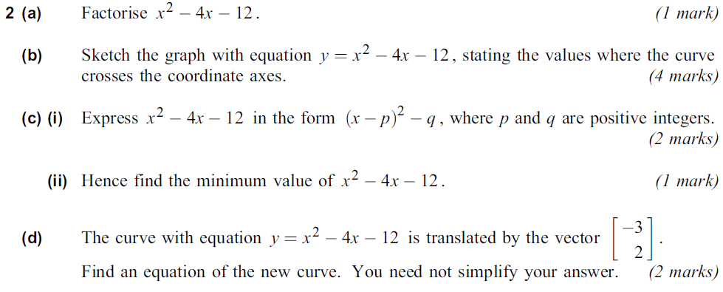

AQA C1 Jane 2012
2.

Slide 25


OCR C1 May 2012

Slide 26
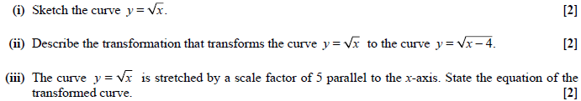
OCR C1 May 2012
5

Slide 27

OCR C1 June 2012

Slide 28
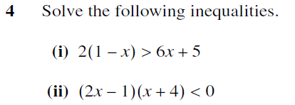
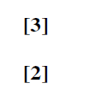
MEI C1 June 2010

