Slide 2
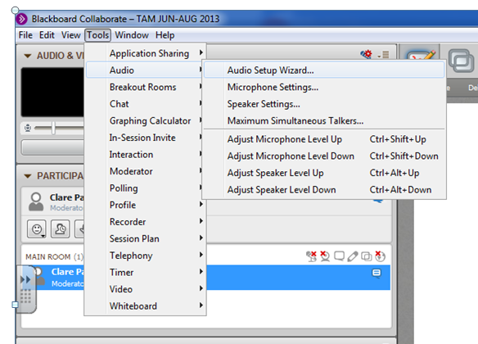
Just arrived? Go to ‘Audio Setup’

Slide 3
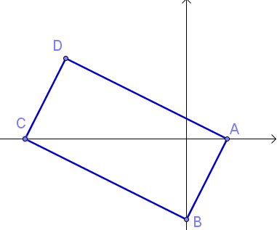
AS Core Maths-TAM Online Session 2: Coordinate Geometry
A warm question to look at while you are waiting
If A is (1,0) and B is (0,-3), what are the equations of the lines making up the rectangle?

Slide 4
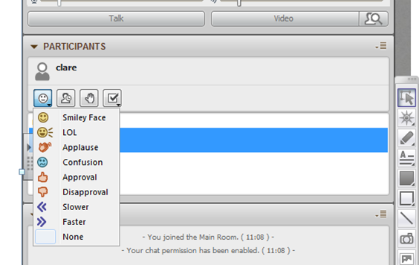




This menu is the quickest way to communicate:
Emotions – give immediate feedback
Time out – it’s polite to tell everyone else if you are leaving the room for a bit
Raise your hand to attract attention.
Respond to a question or take part in a poll.

Slide 5
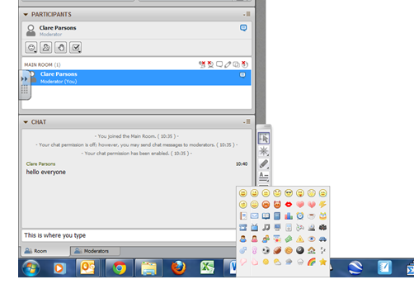
This is the chat box where you can type a message, then either click on “Send” or just press ‘return’ on your keyboard.
A very extensive emotions menu is found by clicking on the smiley face at the end of this box.
You can write on the whiteboard by:
using a pen or mouse
typing in text box

Slide 6
Session Content
Straight lines
Circles
This is content based on chapter 2 in the AS Core textbook

Slide 7
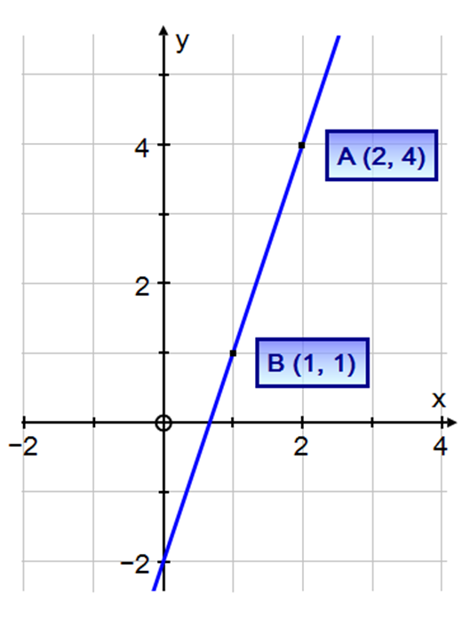
The Basics

Slide 8
(-4,-6)
-1

Slide 9
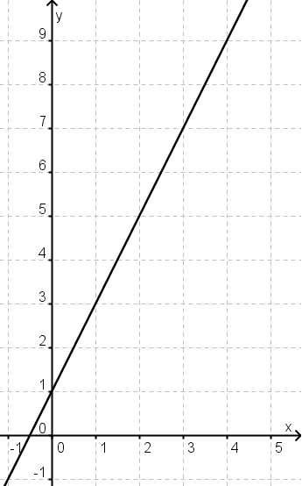
What is meant by ‘the equation of a line’?

Slide 10
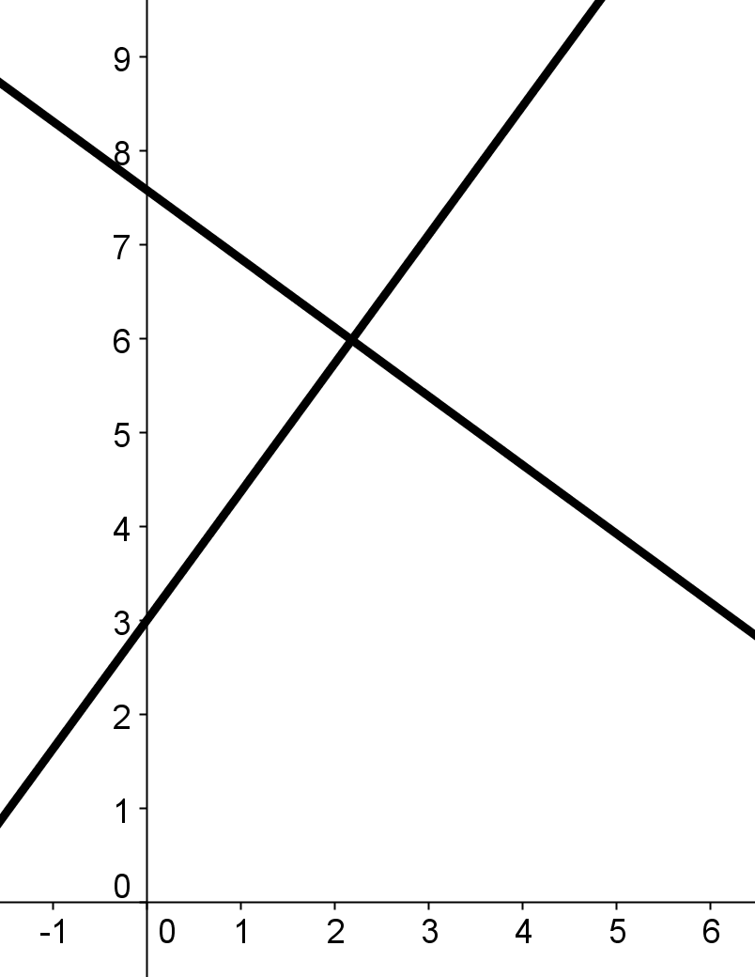
Parallel and perpendicular lines

Slide 11
Back to that starter question…
A(1,0)
B(0,-3)

Slide 12
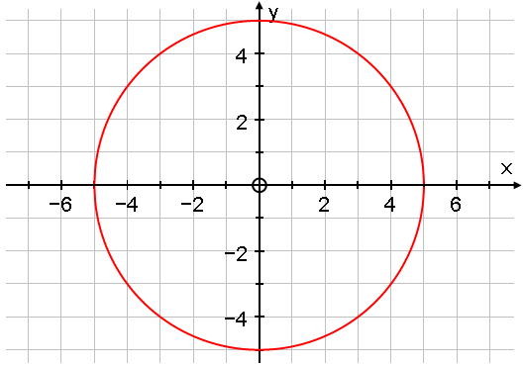
Circles and Pythagoras

Slide 13
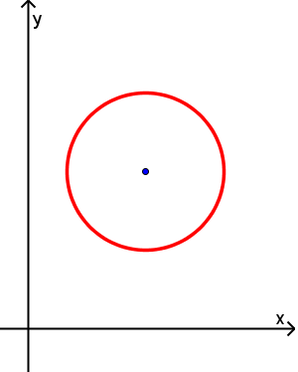
The general circle

Slide 14
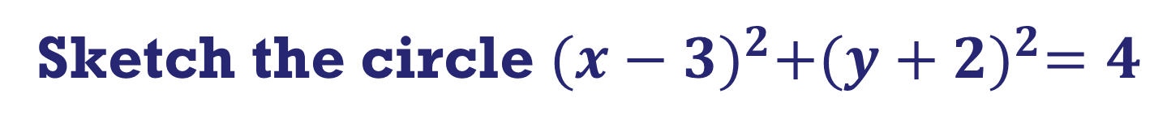
Sketch the circle ${(x−3)}^{2}+{(y+2)}^{2}=4$
COPY A

Slide 15
Sketch the circle ${(x−3)}^{2}+{(y+2)}^{2}=4$
COPY B

Slide 16
Sketch the circle ${(x−3)}^{2}+{(y+2)}^{2}=4$
COPY C

Slide 17
Sketch the circle ${(x−3)}^{2}+{(y+2)}^{2}=4$
COPY D

Slide 18
Sketch the circle ${(x−3)}^{2}+{(y+2)}^{2}=4$
COPY E

Slide 19
Sketch the circle ${(x−3)}^{2}+{(y+2)}^{2}=4$
COPY F

Slide 20

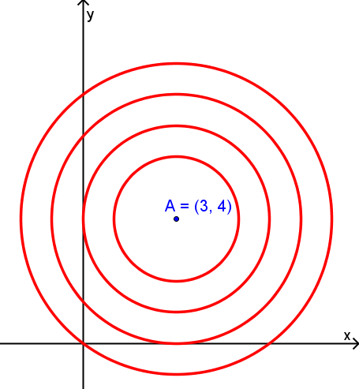
Concentric circles
$${\left(x−3\right)}^{2}+{\left(y−4\right)}^{2}=16$$
Notes:
Label circles A, B, C, D
Vote after 1 min

Slide 21

Concentric circles (2)
$$x^{2}−6x+y^{2}−8y=0$$
a)
b)
c)
d)
Notes:
Label circles A, B, C, D
Vote after 1 min

Slide 22
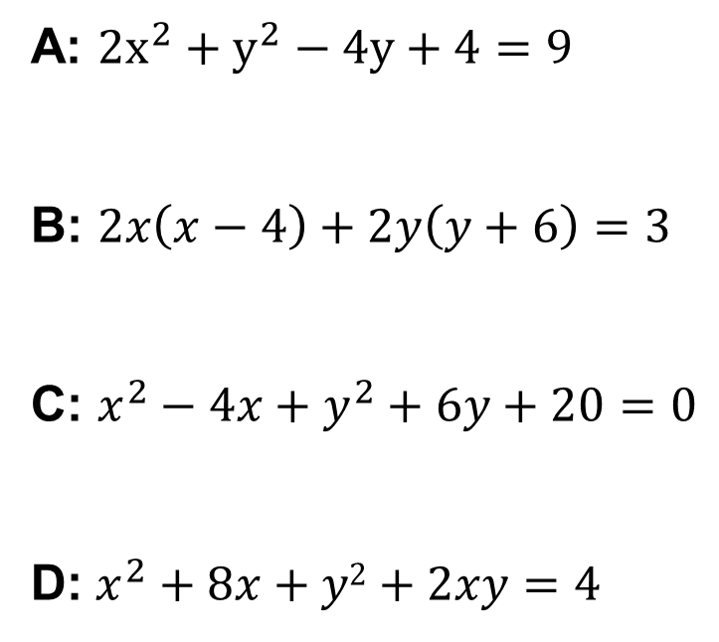
Which one is the equation of a circle?
A: ${2x}^{2}+y^{2}−4y+4=9$
B: $2x\left(x−4\right)+2y\left(y+6\right)=3$
C: $x^{2}−4x+y^{2}+6y+20=0$
D: $x^{2}+8x+y2+2xy=4$

Slide 23
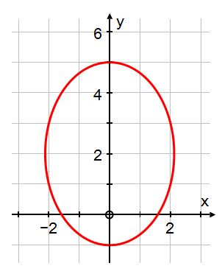
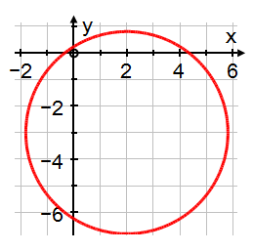
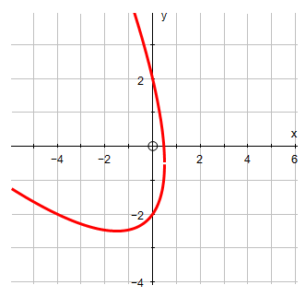
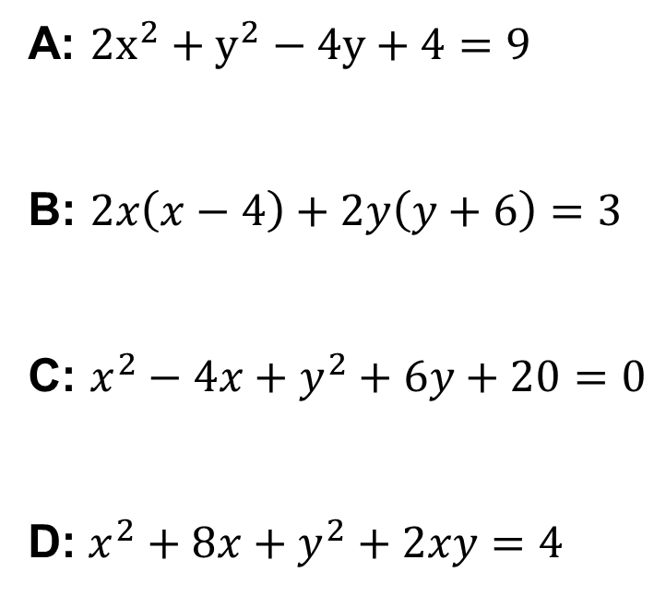
Which one is the equation of a circle?
A: ${2x}^{2}+y^{2}−4y+4=9$
B: $2x\left(x−4\right)+2y\left(y+6\right)=3$
C: $x^{2}−4x+y^{2}+6y+20=0$
D: $x^{2}+8x+y^{2}+2xy=4$

Slide 24

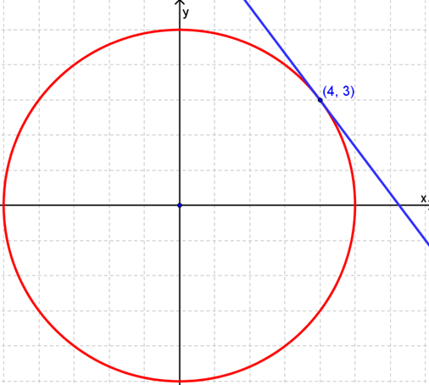

Slide 25
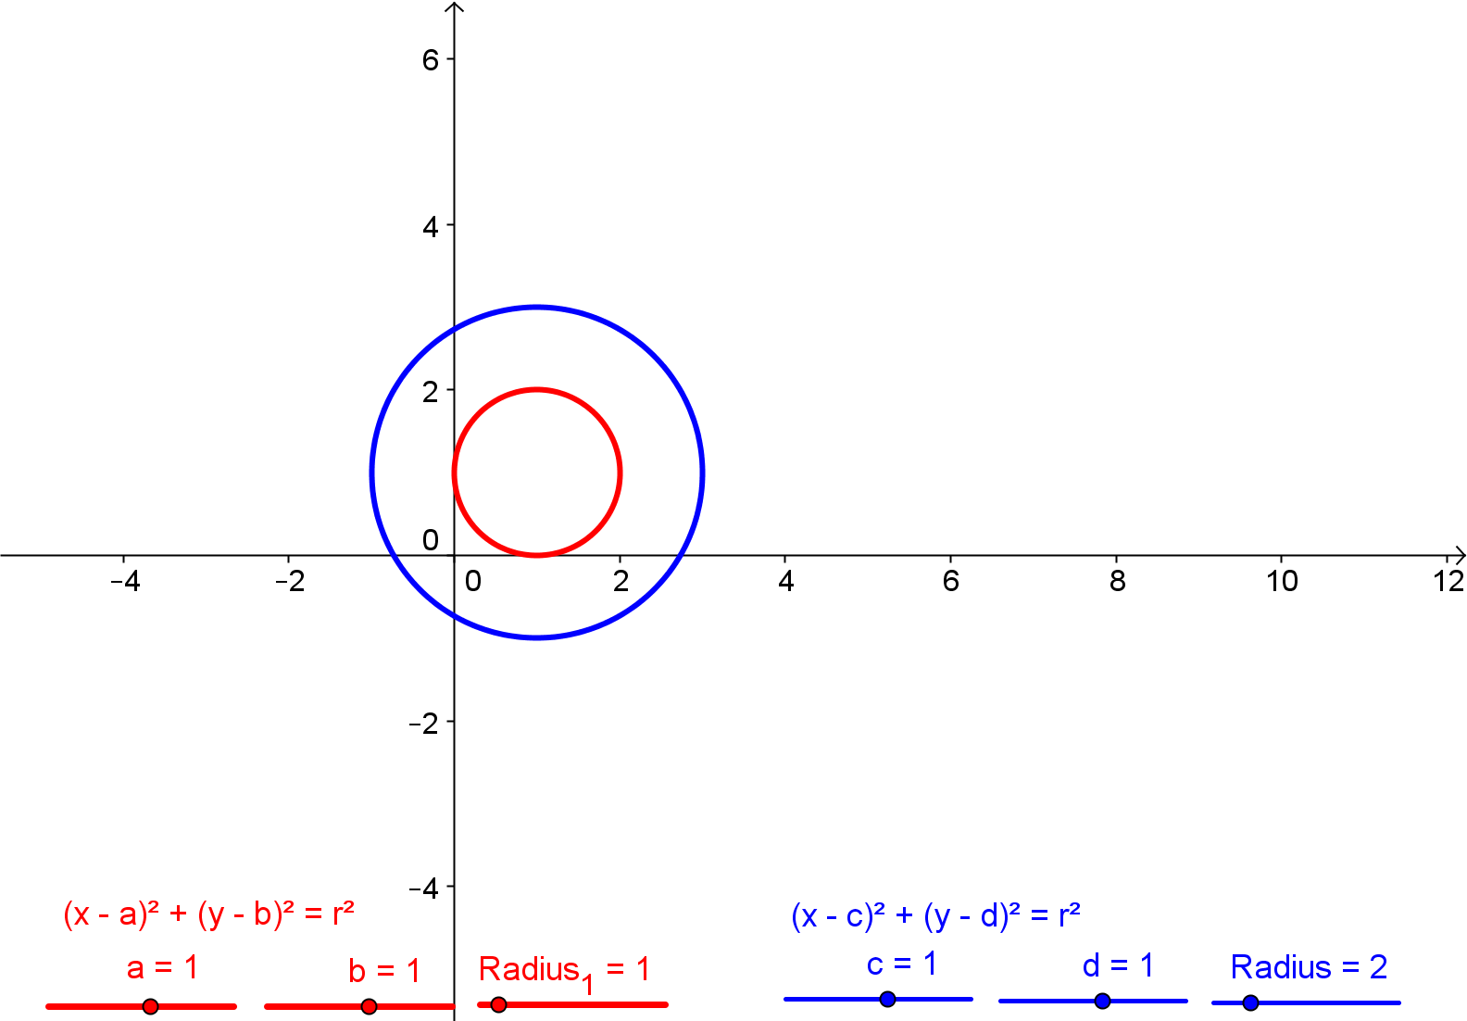
A few questions to promote thinking…

Slide 26
A few questions to promote thinking…
The circle has centre (2, 3) and radius 5. What are the lengths of tangents to (10,0)?

Slide 27
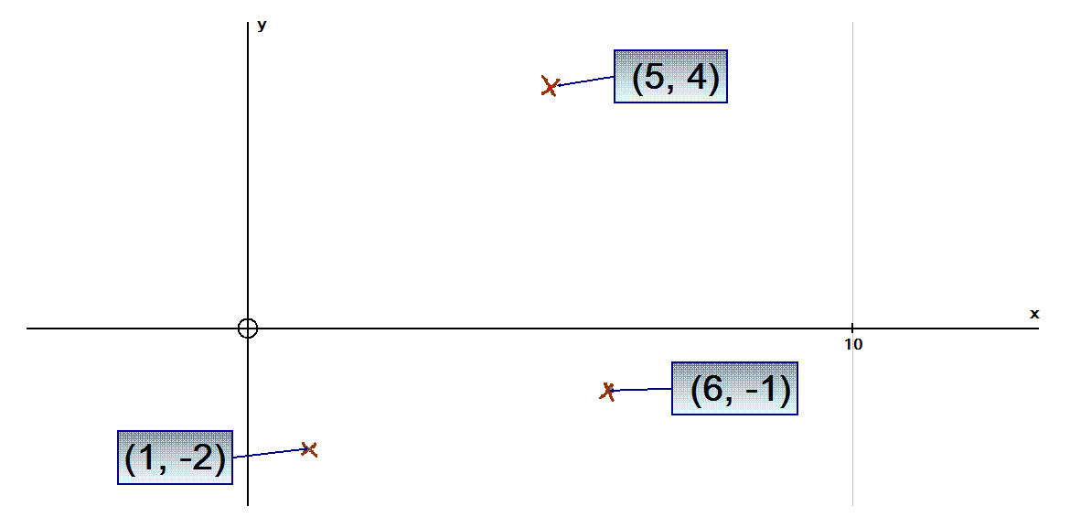
A few questions to promote thinking…
Find the equation of the circle passing through any 3 points of your choice

Slide 28
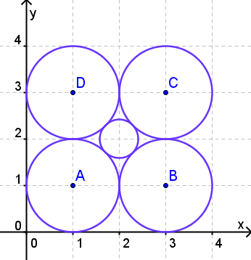
A few questions to promote thinking…
Find the equation of the small circle

Slide 29
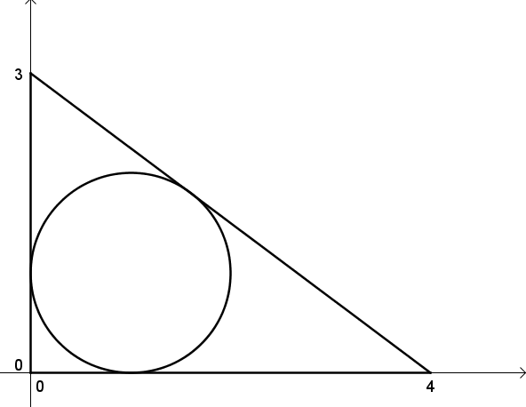
A few questions to promote thinking…
Find the equations of the line and the circle

Slide 30
Session content check
Straight lines
Circles

Slide 31
MEI C1 JUNE 2010 NO. 3

Slide 32
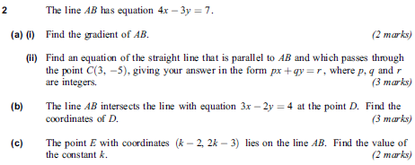
AQA C1 May 2012 no. 2

Slide 33
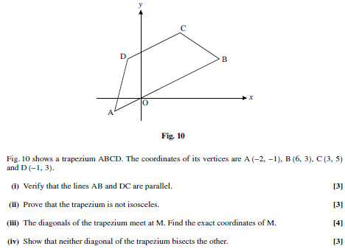
MEI C1 JUNE 2010 NO. 10

Slide 34
EDEXCEL C2 Jan 2013 no. 5

Slide 35
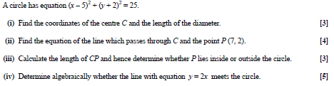
OCR C1 May 2012 NO. 10

Slide 36
EDEXCEL C2 JUNE 2013 NO. 10

