Slide 1
Section 2: Multiple choice
Which of the following is NOT an algorithm?
  A set of instructions used to build a wardrobe
  A flow chart used to solve a quadratic equation
  A note to the milkman asking for 2 pints of milk
2. When would you use a matching algorithm?
  To allocate jobs to five people
  To sort a group into alphabetical order
  To find the cheapest way of getting from Rotherham to Edinburgh by bus
3. When would you use Djikstra’s algorithm
  To allocate jobs to five people
  To sort a group into alphabetical order
  To find the cheapest way of getting from Rotherham to Edinburgh by bus
4. To find the minimum profit on a graph:
  Look for the last point in the region parallel to a profit line
  Look for the first point in the region parallel to a profit line
  Look for the first point in the region perpendicular to a profit line
How would you begin to solve a route inspection problem?
  By identifying the odd nodes and finding shortest pairs
  By finding a Hamiltonian cycle.
  By following a labelling procedure

Slide 2
Section 3: Definitions
The last letter of each answer is the first letter of the next answer.
Graphs that show the same information but are drawn differently are known as…
A graph in which every vertex is directly connect by an edge to each of the other vertices is known as a ….. graph.
In an activity network the top box represents …
4. The final node in an activity network is known as the ….. node
5. A method of finding the minimum spanning tree that cannot be applied to a matrix

Slide 3
Section 4: Quick calculations
Find the length of the shortest path in picture 1
State the shortest path between S and T in question 1
Give an inequality for line 1 in picture 2.
Which activities must be happening at 9.30 in picture 3?
Give the results of the second pass for picture 2

Slide 4
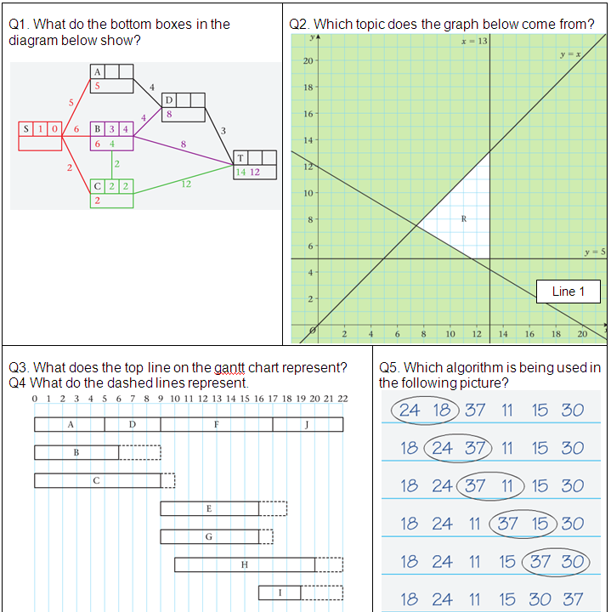
Section 1: Picture round
1. Working values
2. Linear programming
3. The critical path/
critical events
4. The float
5. Bubble
sort

Slide 5
Section 2: Multiple choice
Which of the following is NOT an algorithm?
  A set of instructions used to build a wardrobe
  A flow chart used to solve a quadratic equation
  A note to the milkman asking for 2 pints of milk
2. When would you use a matching algorithm?
  To allocate jobs to five people
  To sort a group into alphabetical order
  To find the cheapest way of getting from Rotherham to Edinburgh by bus
3. When would you use Djikstra’s algorithm
  To allocate jobs to five people
  To sort a group into alphabetical order
  To find the cheapest way of getting from Rotherham to Edinburgh by bus
4. To find the minimum profit on a graph:
  Look for the last point in the region parallel to a profit line
  Look for the first point in the region parallel to a profit line
  Look for the first point in the region perpendicular to a profit line
How would you begin to solve a route inspection problem?
  By identifying the odd nodes and finding shortest pairs
  By finding a Hamiltonian cycle.
  By following a labelling procedure

Slide 6
Section 3: Definitions
The last letter of each answer is the first letter of the next answer.
Graphs that show the same information but are drawn differently are known as…
Isomorphic
A graph in which every vertex is directly connect by an edge to each of the other vertices is known as a ….. graph.
Complete
In an activity network the top box represents …
Early event times
4. The final node in an activity network is known as the ….. node
Sink
5. A method of finding the minimum spanning tree that cannot be applied to a matrix
Kruskals

Slide 7
Section 4: Quick calculations
Find the length of the shortest path in picture 1
11
State the shortest path between S and T in question 1
S – C – B – D – T
Give an inequality for line 1 in picture 2.
3x + 5y ≥ 60
Which activities must be happening at 9.30 in picture 3?
F, E and G
Give the results of the second pass for picture 2
18 11 15 24 30 37

