Slide 2
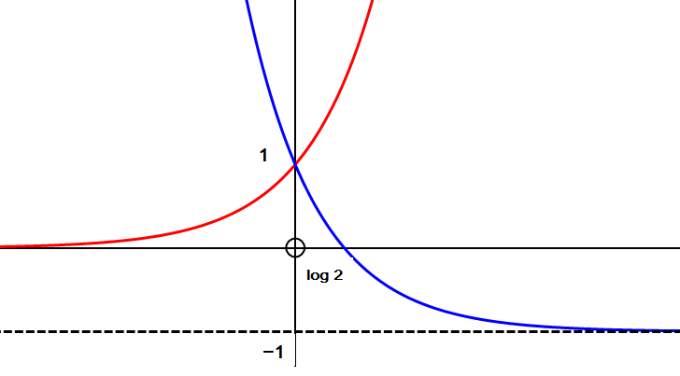
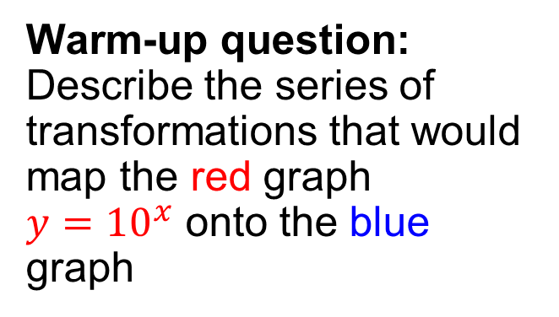
AS Core Maths - TAM Online Session 9: Logarithms & Exponentials
Warm-up question: Describe the series of transformations that would map the red graph $y={10}^{x}$ onto the blue graph

Slide 3
Session content
Basic logarithms
Laws of Logarithms
Solving equations using logarithms
Reducing to linear form
NB: This is content based on chapter 11 in the AS core textbook

Slide 4

What are logarithms?
Make x the subject of $y=x^{2}$
Make x the subject of $y=2^{x}$

Slide 5

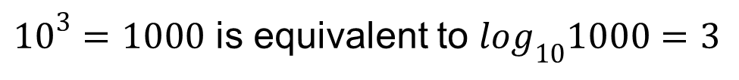
The link with indices
${10}^{3}=1000$ is equivalent to $\log_{10}1000=3$
$$\log_{10}{10}^{a}=a$$

Slide 6
The link with indices
${10}^{3}=1000$ is equivalent to $\log_{10}1000=3$
$$\log_{10}{10}^{a}=a$$
$\log_{5}125=A$ $\log_{2}\left(\frac{1}{4}\right)=B$ $\log_{10}0.1=C$

Slide 7
The link with indices
${10}^{3}=1000$ is equivalent to $\log_{10}1000=3$
$$\log_{10}{10}^{a}=a$$
$\log_{5}125=3$ $\log_{2}\left(\frac{1}{4}\right)=−2$ $\log_{10}0.1=−1$
$\log_{5}P=−1$ $\log_{4}Q=2$ $\log_{8}R=0$

Slide 8
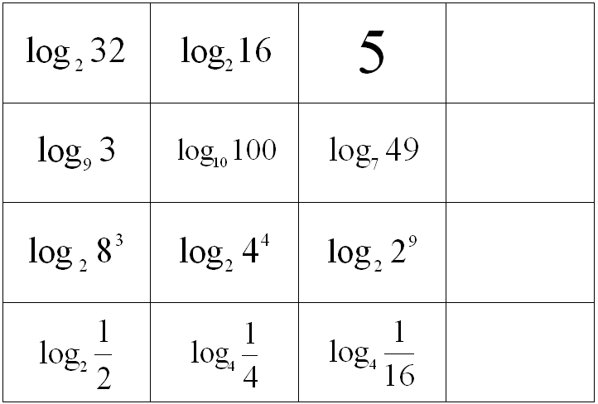
Odd one out

Slide 9

The laws of logarithms
If $a={10}^{p} and b={10}^{q}$ , then $\log_{10}a=p$ and $\log_{10}b=q$
$$\log_{10}ab=$$
$$\log_{10}\frac{a}{b}=$$
$$\log_{10}a^{n}=$$

Slide 10
MEI Core 2, Jun 07 - Q6 [5 marks]

Slide 11
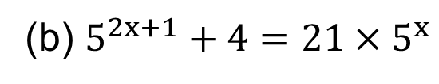
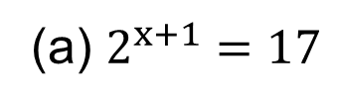
Solving Equations (1)
(a) $2^{x+1}=17$
(b) $5^{2x+1}+4=21×5^{x}$

Slide 12
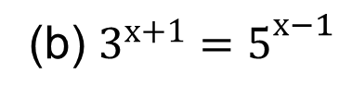
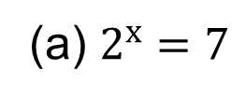
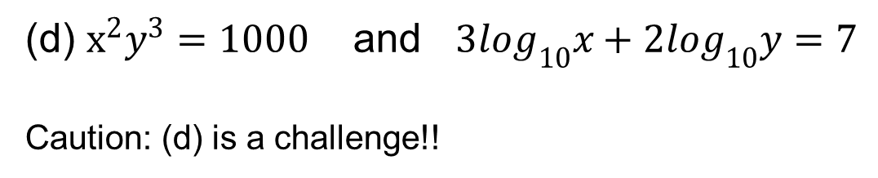
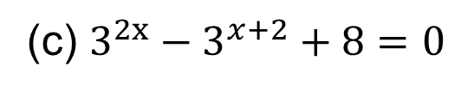
Solving Equations (2)
(a) $2^{x}=7$
(b) $3^{x+1}=5^{x−1}$
(c) $3^{2x}−3^{x+2}+8=0$
(d) $x^{2}y^{3}=1000$ and $3\log_{10}x+2\log_{10}y=7$
Caution: (d) is a challenge!!

Slide 13
Solving Equations (3)
(a) $2^{x}=7$

Slide 14
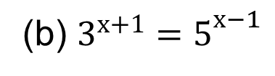
Solving Equations (4)
(b) $3^{x+1}=5^{x−1}$

Slide 15
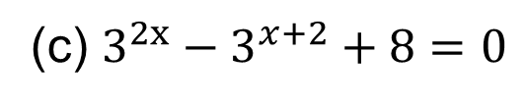
Solving Equations (5)
(c) $3^{2x}−3^{x+2}+8=0$

Slide 16
Solving Equations (6)
(d) $x^{2}y^{3}=1000$ and $3\log_{10}x+2\log_{10}y=7$

Slide 17
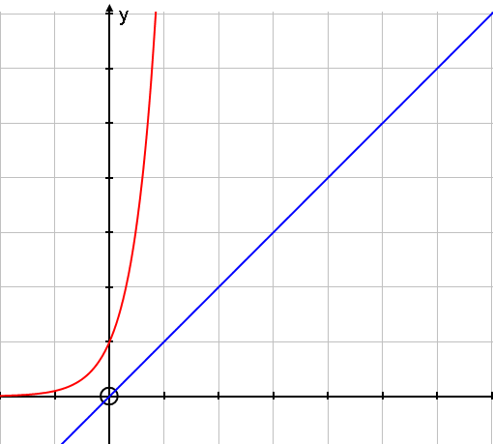
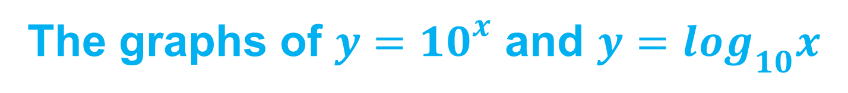
The graphs of $y={10}^{x}$ and $y=\log_{10}x$

Slide 18
Transformations

Slide 19
Back to the warm-up question…

Slide 20
Reducing to linear form (MEI)
x | 1.5 | 2.7 | 3.4 | 8.1 | 10
y | 9 | 19 | 32 | 820 | 3100

Slide 21
x | 1.5 | 2.7 | 3.4 | 8.1 | 10
y | 9 | 19 | 32 | 820 | 3100
log y | 0.95 | 1.28 | 1.51 | 2.91 | 3.49

Slide 22
Reducing to linear form (MEI)
x | 1.51 | 2.13 | 3.50 | 4.62 | 5.07 | 7.21
y | 2.09 | 2.75 | 4.09 | 5.10 | 6.21 | 7.28

Slide 23
x | 1.51 | 2.13 | 3.50 | 4.62 | 5.07 | 7.21
y | 2.09 | 2.75 | 4.09 | 5.10 | 6.21 | 7.28
log x | 0.18 | 0.33 | 0.54 | 0.66 | 0.71 | 0.86
log y | 0.32 | 0.44 | 0.61 | 0.71 | 0.79 | 0.86

Slide 24
Session content check
Basic logarithms
Laws of Logarithms
Solving equations using logarithms
Reducing to linear form

Slide 25
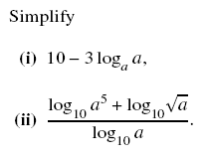
MEI Core 2, Jun 09 - Q9 [3 marks]

Slide 26
MEI Core 2, Jan 07 - Q10 [4 marks]

Slide 27
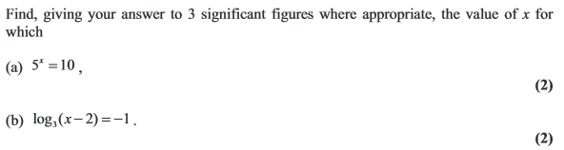
Edexcel Core 2, Jun 11 - Q3 [4 marks]

Slide 28
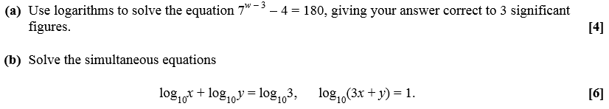
OCR Core 2, Jan 12 - Q8 [10 marks]

Slide 29
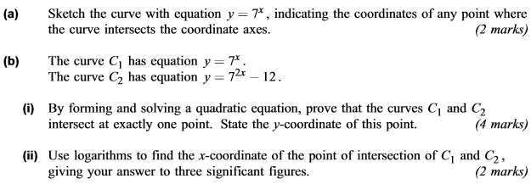
AQA Core 2, Jun 12 - Q8 [8 marks]

Slide 30
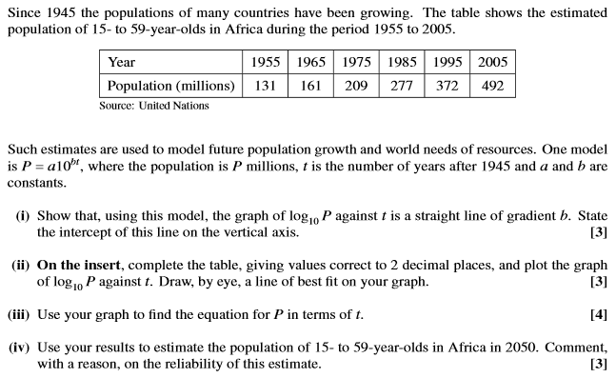
MEI Core 2, Jan 10 - Q12 [13 marks]

Slide 31
