Slide 2
AS Core Maths - TAM Online Session 5: Integration
A warm-up question before we get started…
On the next screen is a curve.
Here are two pieces of information about it:
- It has gradient function
- It passes through the point with coordinates (3,2)
What is the equation of the curve?

Slide 3
Session content
Basic ideas of integration
Definite & Indefinite integration
Finding areas under and between curves
Trapezium rule
NB: This is content based on chapters 9 & 12 in the AS core textbook

Slide 4
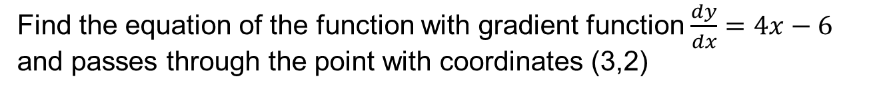
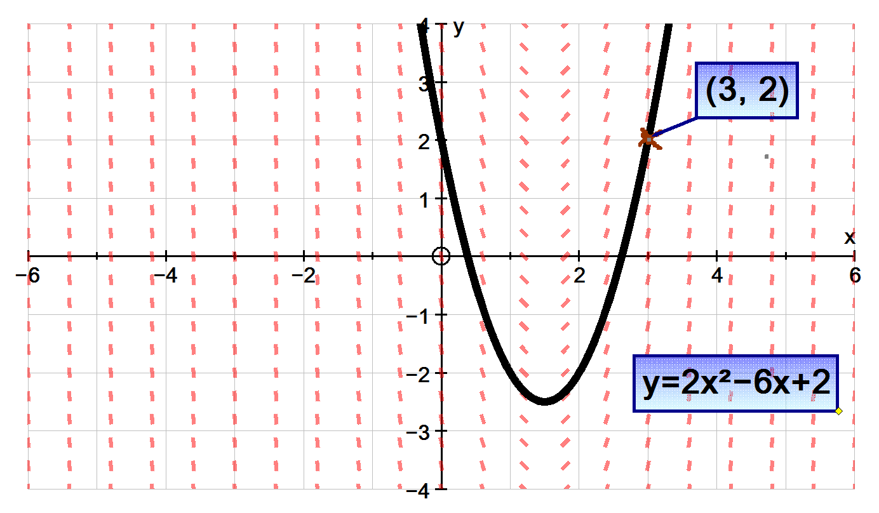
Using Autograph to illustrate solutions to differential equations
Notes:
Interesting sequences? Tarsia doc?

Slide 5
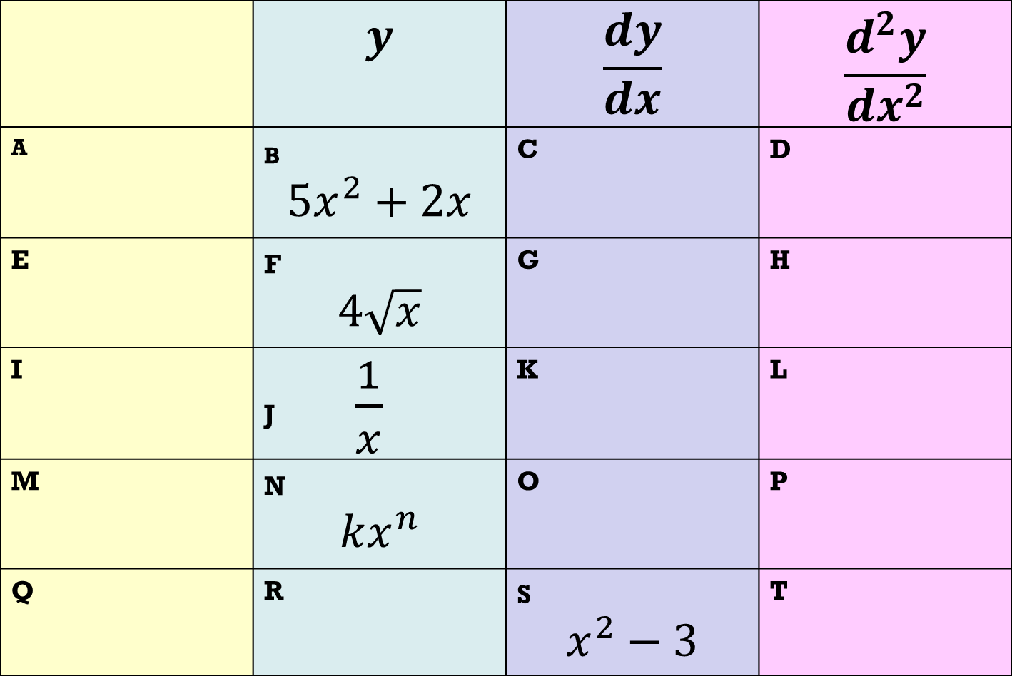
text
Notes:
Interesting sequences? Tarsia doc?

Slide 6
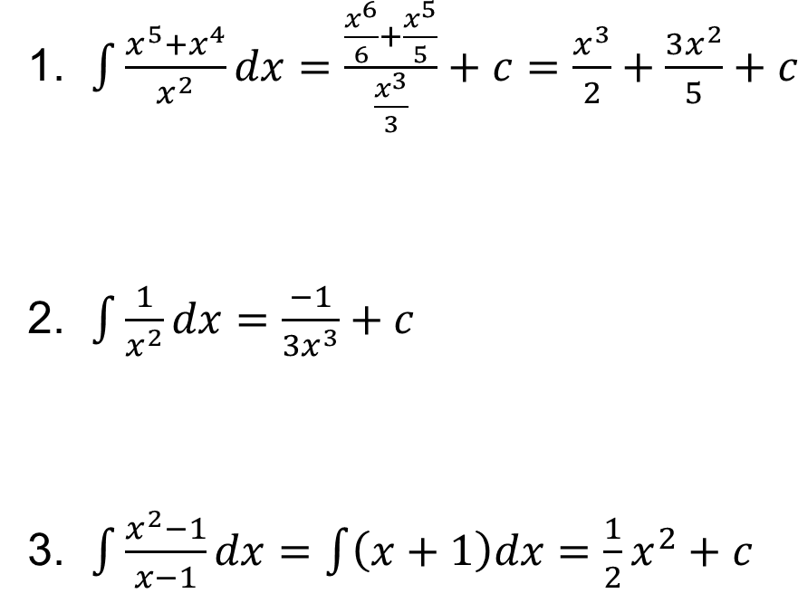
Spot the errors
Notes:
Interesting sequences? Tarsia doc?

Slide 7
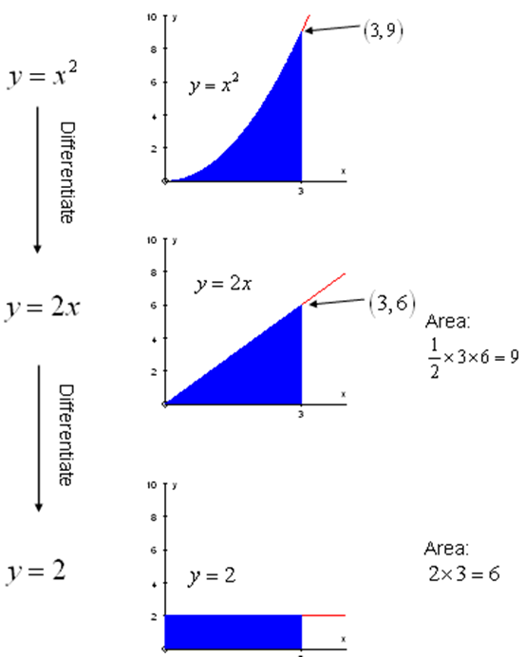
Is there a link between integration and area?
Notes:
Interesting sequences? Tarsia doc?

Slide 8
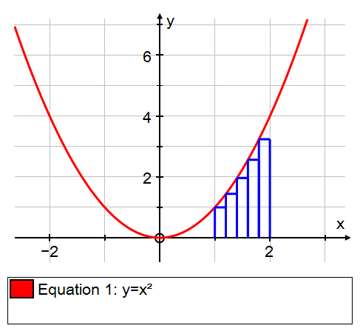
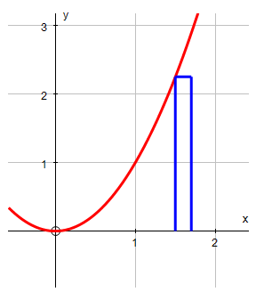
The Fundamental theorem of calculus

Slide 9
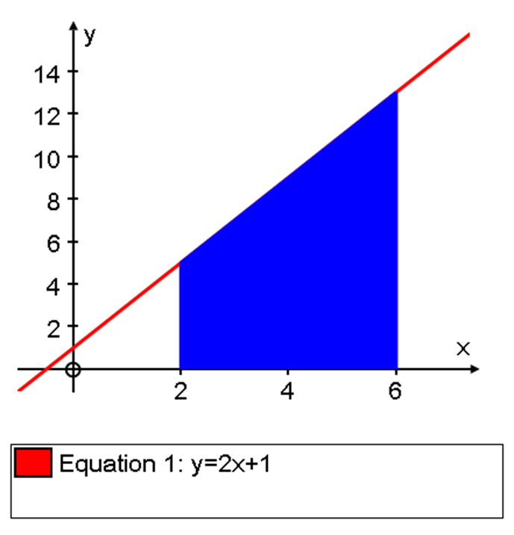
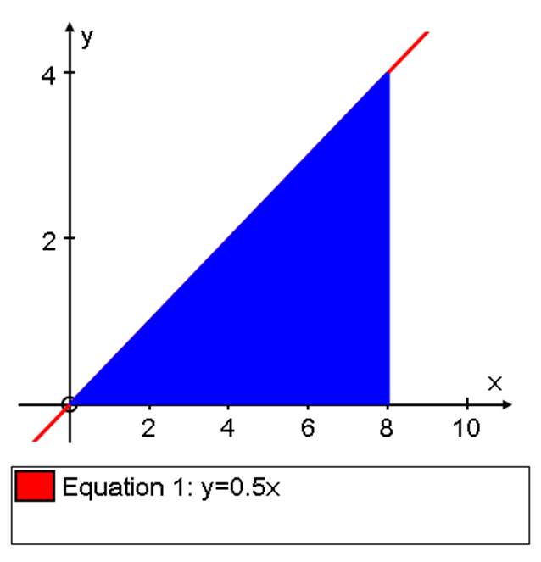
Definite Integrals
Notes:
Interesting sequences? Tarsia doc?

Slide 10
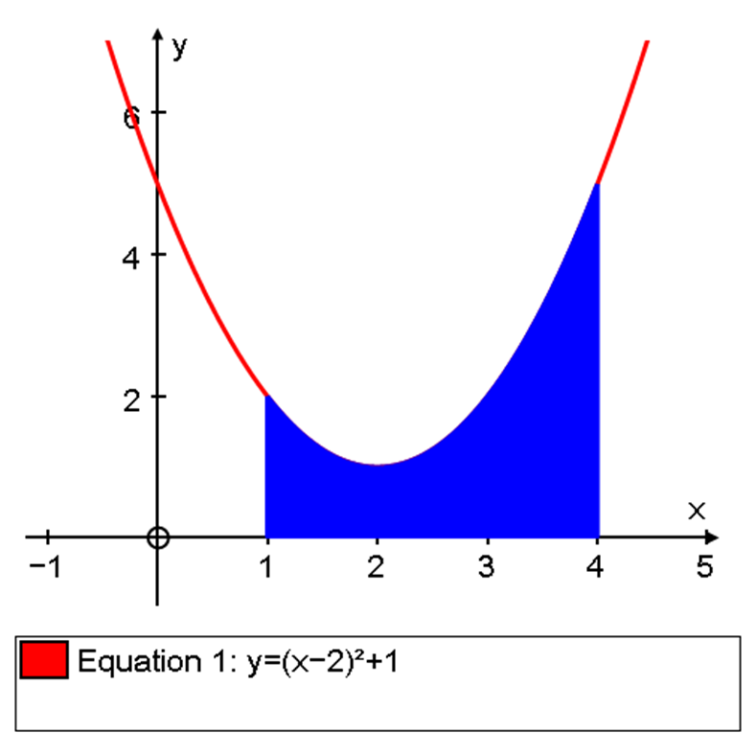
Definite Integrals
Notes:
Interesting sequences? Tarsia doc?

Slide 11
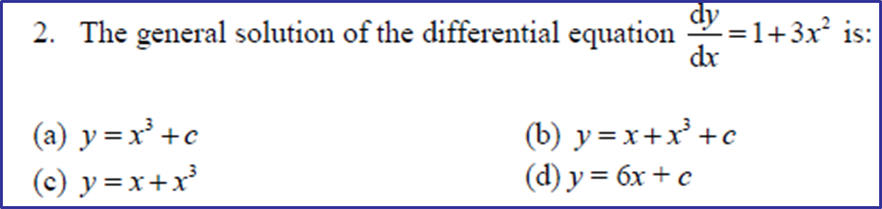
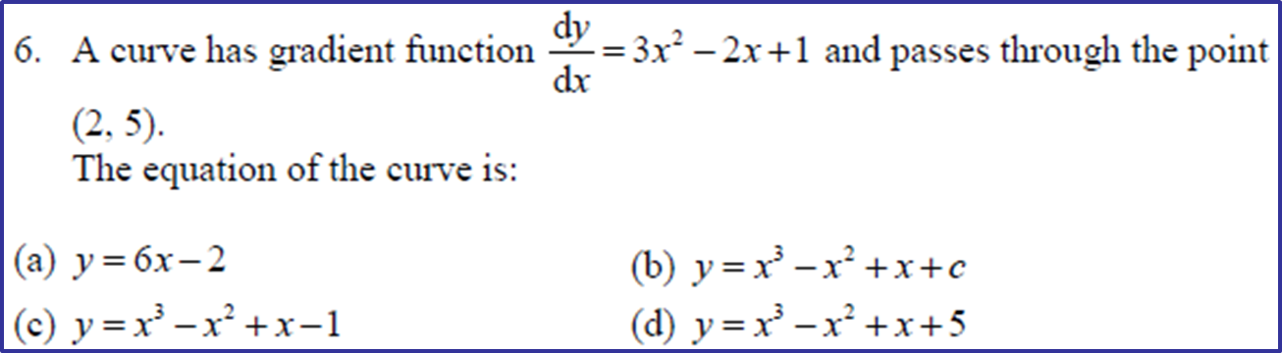
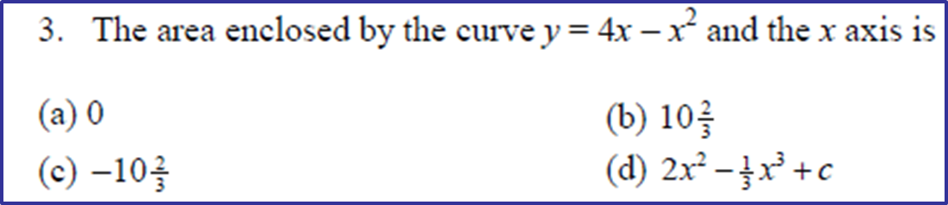
Some multi-choice questions
1
text
2
Notes:
Interesting sequences? Tarsia doc?

Slide 12
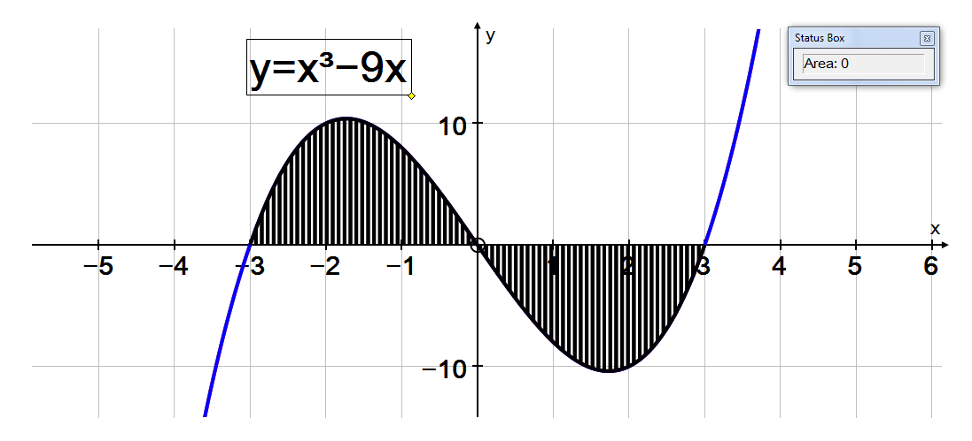
Area of a region below the x-axis
Notes:
Interesting sequences? Tarsia doc?

Slide 13
Area between two curves
Notes:
Interesting sequences? Tarsia doc?

Slide 14
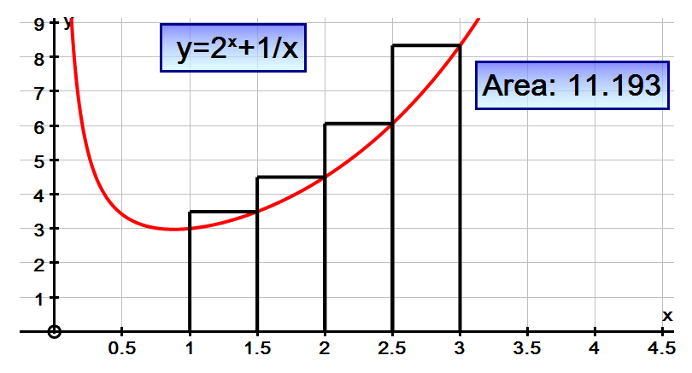
Numerical methods
text
Notes:
Interesting sequences? Tarsia doc?

Slide 15
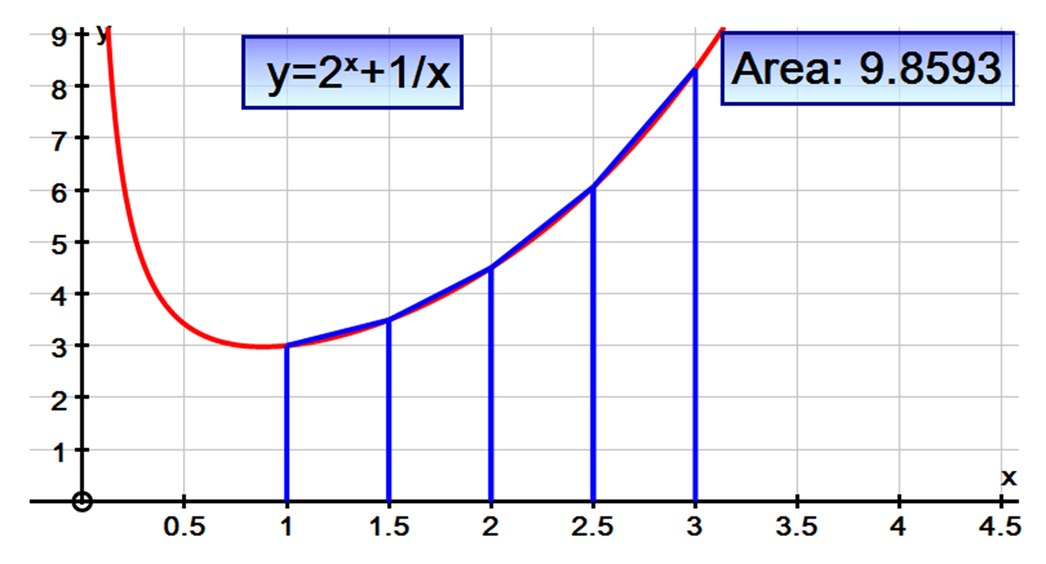
The Trapezium Rule
Notes:
Interesting sequences? Tarsia doc?

Slide 16
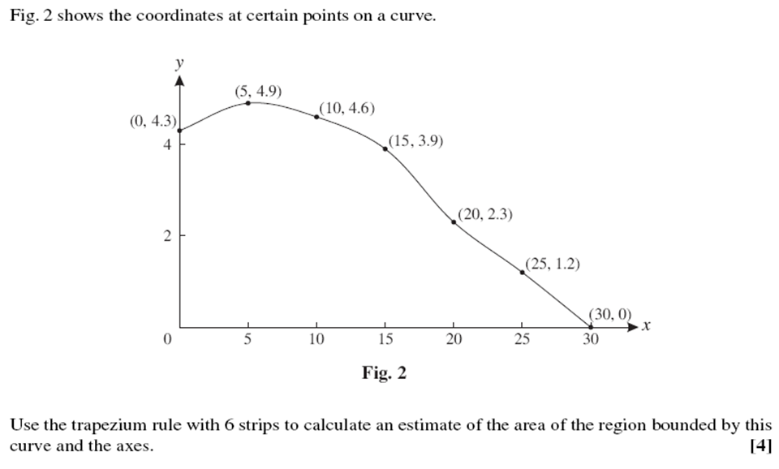
Typical Trapezium Rule Exam Question (MEI Core 2 Jan 09 – Q2 ,4marks)

Slide 17
Session content check
Basic ideas of integration
Definite & Indefinite integration
Finding areas under and between curves
Trapezium rule

Slide 18
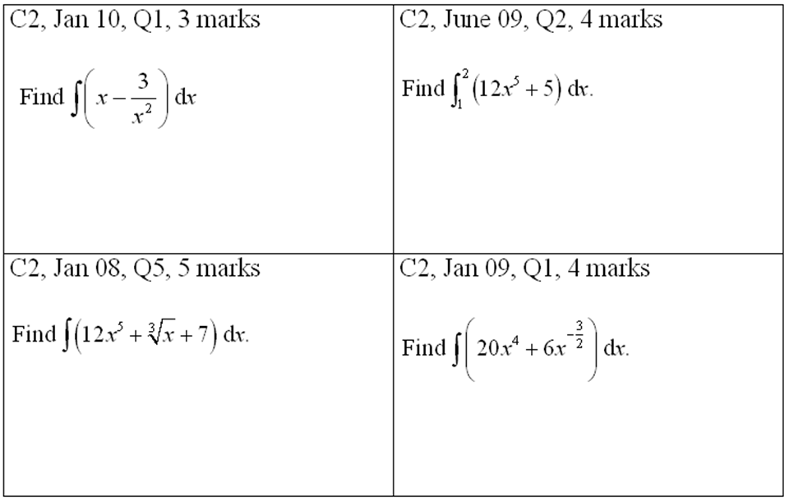
MEI Core 2 Section A questions

Slide 19
MEI Core 2 May 11 – Q6, 5 marks

Slide 20
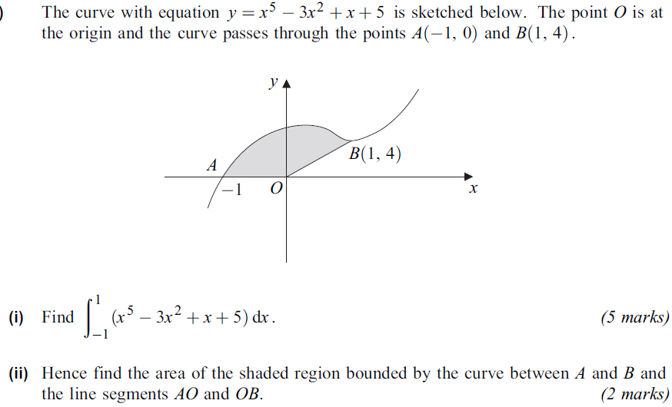
AQA C1 Jan12 – Q4d(part question ) 7 marks marksquesquestopn
(2)

Slide 21
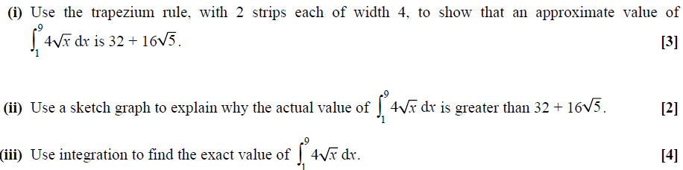
OCR Core 2 May 12 13 – Q6,9 marks

Slide 22
Edexcel Core 2 Jan 13 – Q9
x | 1 | 1.5 | 2 | 2.5 | 3 | 3.5 | 4
y | 0 | 5.866 |  | 5.210 |  | 1.856 | 0
(2)

