Slide 2
AS Core Maths - TAM Online Session 8: Trigonometry
A warm-up question:
The diagram shows two circles, the radius of the larger one being the diameter of the smaller one. Prove that the arc lengths AB and A’B’ are equal.

Slide 3
Session Content
Basic trigonometry
Graphs of trig functions
Solving trig equations
Transformations
Radians
Arcs & sectors
NB: This is content based on chapter 10 in the AS core textbook

Slide 4
GCSE recap: Exact values
 | 0° | 30° | 45° | 60° | 90°
sin 𝜃
cos 𝜃
tan 𝜃

Slide 5
GCSE recap: Area of a triangle & the sine rule

Slide 6
GCSE recap: The cosine rule

Slide 7
How long do you think x is?
x
6 cm
40º
8 cm
Not to scale

Slide 8
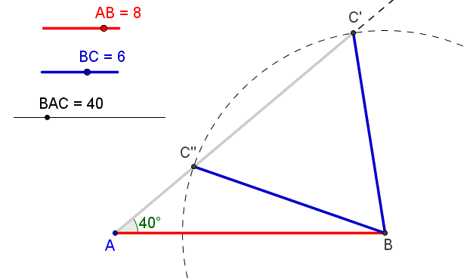
The ambiguous case

Slide 9
Why does my calculator say that sin 150 is 0.5 when you can’t have a right-angled triangle with an angle of 150?

Slide 10
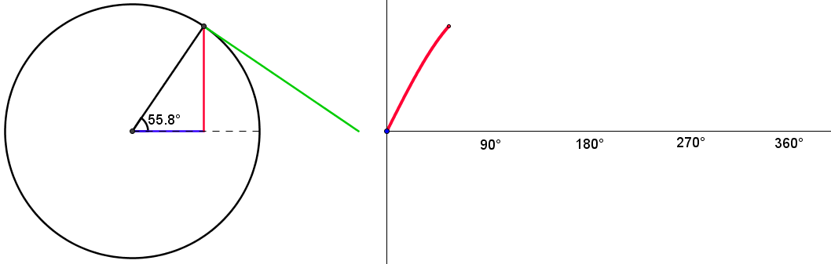
Extending the domain: circular functions

Slide 11
Trigonometric identities

Slide 12
If x is obtuse and sin x =0.4, find cos x and tan x
Question

Slide 14
Core 2 Jun 07 - Q8 [5 marks]

Slide 15
Transformations

Slide 16
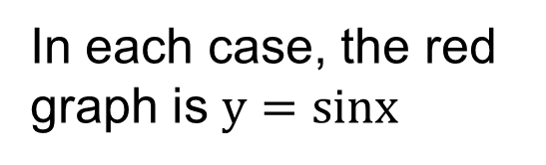
Transformations
In each case, the red graph is $y=sinx$

Slide 17
Find the equations

Slide 18
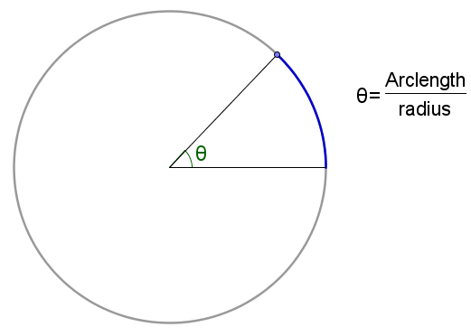
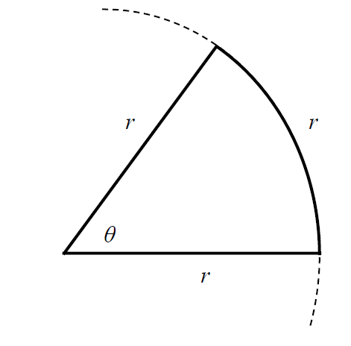
Radians

Slide 19
Radians and degrees

Slide 20
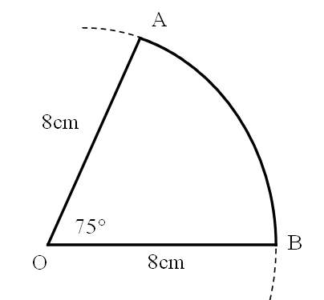
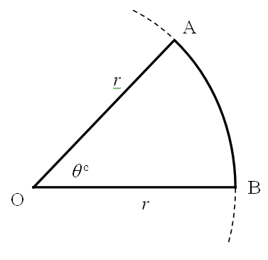
Arc length and area of sector

Slide 21
Arcs and Sectors exam style questions
1. Core 2 Jan 10 - Q4 [3 marks]
A sector of a circle has area 8.45cm² and sector angle 0.4 radians. Calculate the radius of the sector.
2. Core 2 May 09 - Q4 [4 marks]
A sector of a circle of radius 18.0cm has arc length 43.2cm.
(i) Find in radians the angle of the sector.
(ii) Find this angle in degrees, giving your answer to the nearest degree.

Slide 22
The diagram shows two circles, the radius of the larger one being the diameter of the smaller one. Prove that the arc lengths AB and A’B’ are equal.

Slide 23
Session content check
Basic trigonometry
Graphs of trig functions
Solving trig equations
Transformations
Radians
Arcs & sectors

Slide 24

MEI Core 2 May 09 - Q5 [5 marks ]

Slide 25
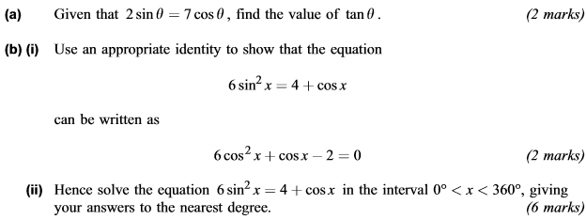
AQA Core 2 - Jan 12, Q8 [10 marks]

Slide 26
MEI Core 2 Jan 09 - Q4 [3 marks]
Solve the equation $sin2x=−0.5$ for $0°<x<180°$

Slide 27
MEI Core 2 Jan 09 - Q11(i) [6 marks]

Slide 28
MEI Core 2 Jan 09 - Q11(ii) [6 marks]

Slide 29
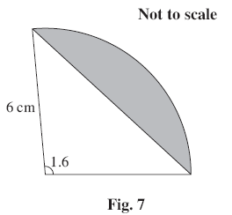
MEI Core 2 Jun 08 - Q7 [5 marks]

Slide 30
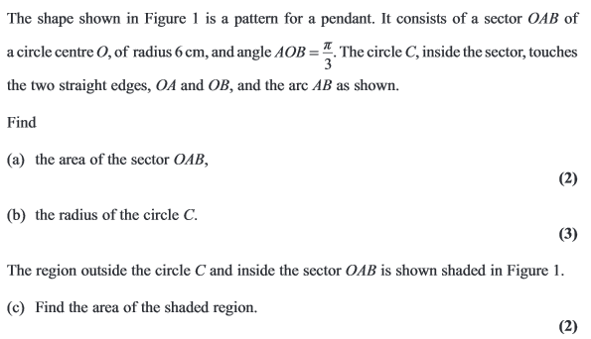
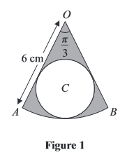
Edexcel Core 2 - Jun 11, Q5 [7 marks]

Slide 31
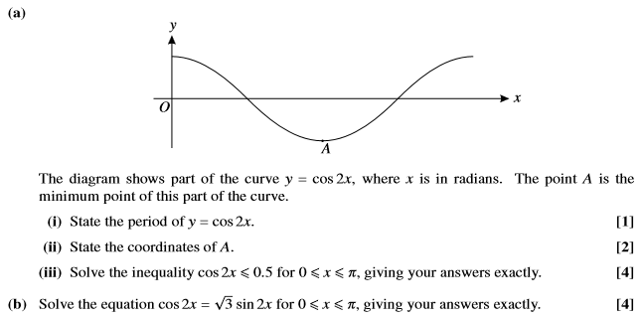
OCR Core 2 Jun 11 - Q9 [11 marks]

