Slide 1
Section 2: Multiple choice
When would you use a bin-packing algorithm?
To sort a group into alphabetical order
To work out how many pieces of wood you needed for a building project
To allocate jobs to five people
Which of the following is true of Djikstra’s algorithm?
Point are labelled in order from left to right
Points are labelled in order according to their distance from the start
Points are labelled in order of the weight of arcs leading to them
How would you begin to solve a route inspection problem?
By finding a Hamiltonian cycle.
By finding earliest and latest times
By identifying the odd nodes and finding shortest pairs
In critical path analysis the lower bound for the number of workers is found by:
Dividing number of tasks by minimum time
Multiplying number of tasks by minimum time
Multiplying total time by minimum time
To find the maximum profit on a graph:
Look for the last point in the region parallel to a profit line
Look for the first point in the region parallel to a profit line
Look for the first point in the region perpendicular to a profit line

Slide 2
Section 3: Definitions
The last letter of each answer is the first letter of the next answer.
A method of finding the minimum spanning tree that can also be applied to a matrix.
A subgraph which includes all vertices and is also a tree
A graph that is traversable is known as…
Another word for a vertex is a …
5. Another word for arc is…

Slide 3
Section 4: Quick calculations
Find an alternating path between D and 1 in picture 1.
Which activities must be taking place at 12.30 on the chart in picture 3?
Find w on picture 2.
10 lengths of fabric need to be cut from rolls of length 6m.
40cm , 320cm , 52cm , 385cm , 72cm, 500cm, 200cm, 95cm, 350cm, 70cm
Calculate the lower bound for the number of rolls needed?
It takes 30 minutes to make a gold coin and 20 minutes to make a silver coins. The company has 3 hours available. Write down an inequality, in terms of x and y, to model this constraint.

Slide 4
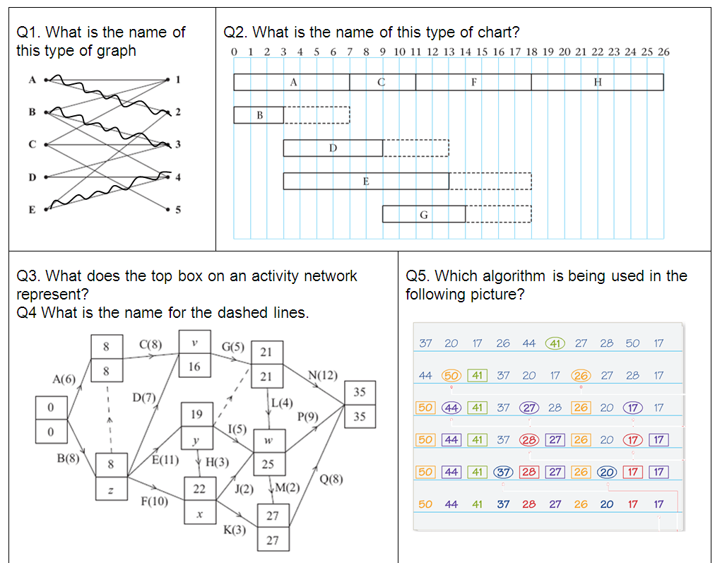
Section 1: Picture round
Bipartitie
Gantt chart
Q3. Early event time
Q5.
Quick sort
Q4.
Dummy

Slide 5
Section 2: Multiple choice
When would you use a bin-packing algorithm?
To sort a group into alphabetical order
To work out how many pieces of wood you needed for a building project
To allocate jobs to five people
Which of the following is true of Djikstra’s algorithm?
Point are labelled in order from left to right
Points are labelled in order according to their distance from the start
Points are labelled in order of the weight of arcs leading to them
How would you begin to solve a route inspection problem?
By finding a Hamiltonian cycle.
By finding earliest and latest times
By identifying the odd nodes and finding shortest pairs
In critical path analysis the lower bound for the number of workers is found by:
Dividing number of tasks by minimum time
Multiplying number of tasks by minimum time
Multiplying total time by minimum time
To find the maximum profit on a graph:
Look for the last point in the region parallel to a profit line
Look for the first point in the region parallel to a profit line
Look for the first point in the region perpendicular to a profit line

Slide 6
Section 3: Definitions
The last letter of each answer is the first letter of the next answer.
A method of finding the minimum spanning tree that can also be applied to a matrix.
Primms
A subgraph which includes all vertices and is also a tree
Spanning tree
A graph that is traversable is known as…
Eulerian
Another word for a vertex is a …
Node
5. Another word for arc is…
Edge

Slide 7
Section 4: Quick calculations
Find an alternating path between D and 1 in picture 1.
D – 4 = E – 2 = A – 1
Which activities must be taking place at 12.30 on the chart in picture 3?
F and E
Find w on picture 2.
25
10 lengths of fabric need to be cut from rolls of length 6m.
40cm , 320cm , 52cm , 385cm , 72cm, 500cm, 200cm, 95cm, 350cm, 70cm
Calculate the lower bound for the number of rolls needed?
6
It takes 30 minutes to make a gold coin and 20 minutes to make a silver coins. The company has 3 hours available. Write down an inequality, in terms of x and y, to model this constraint.
3x + 2y < 18

